Slide 1
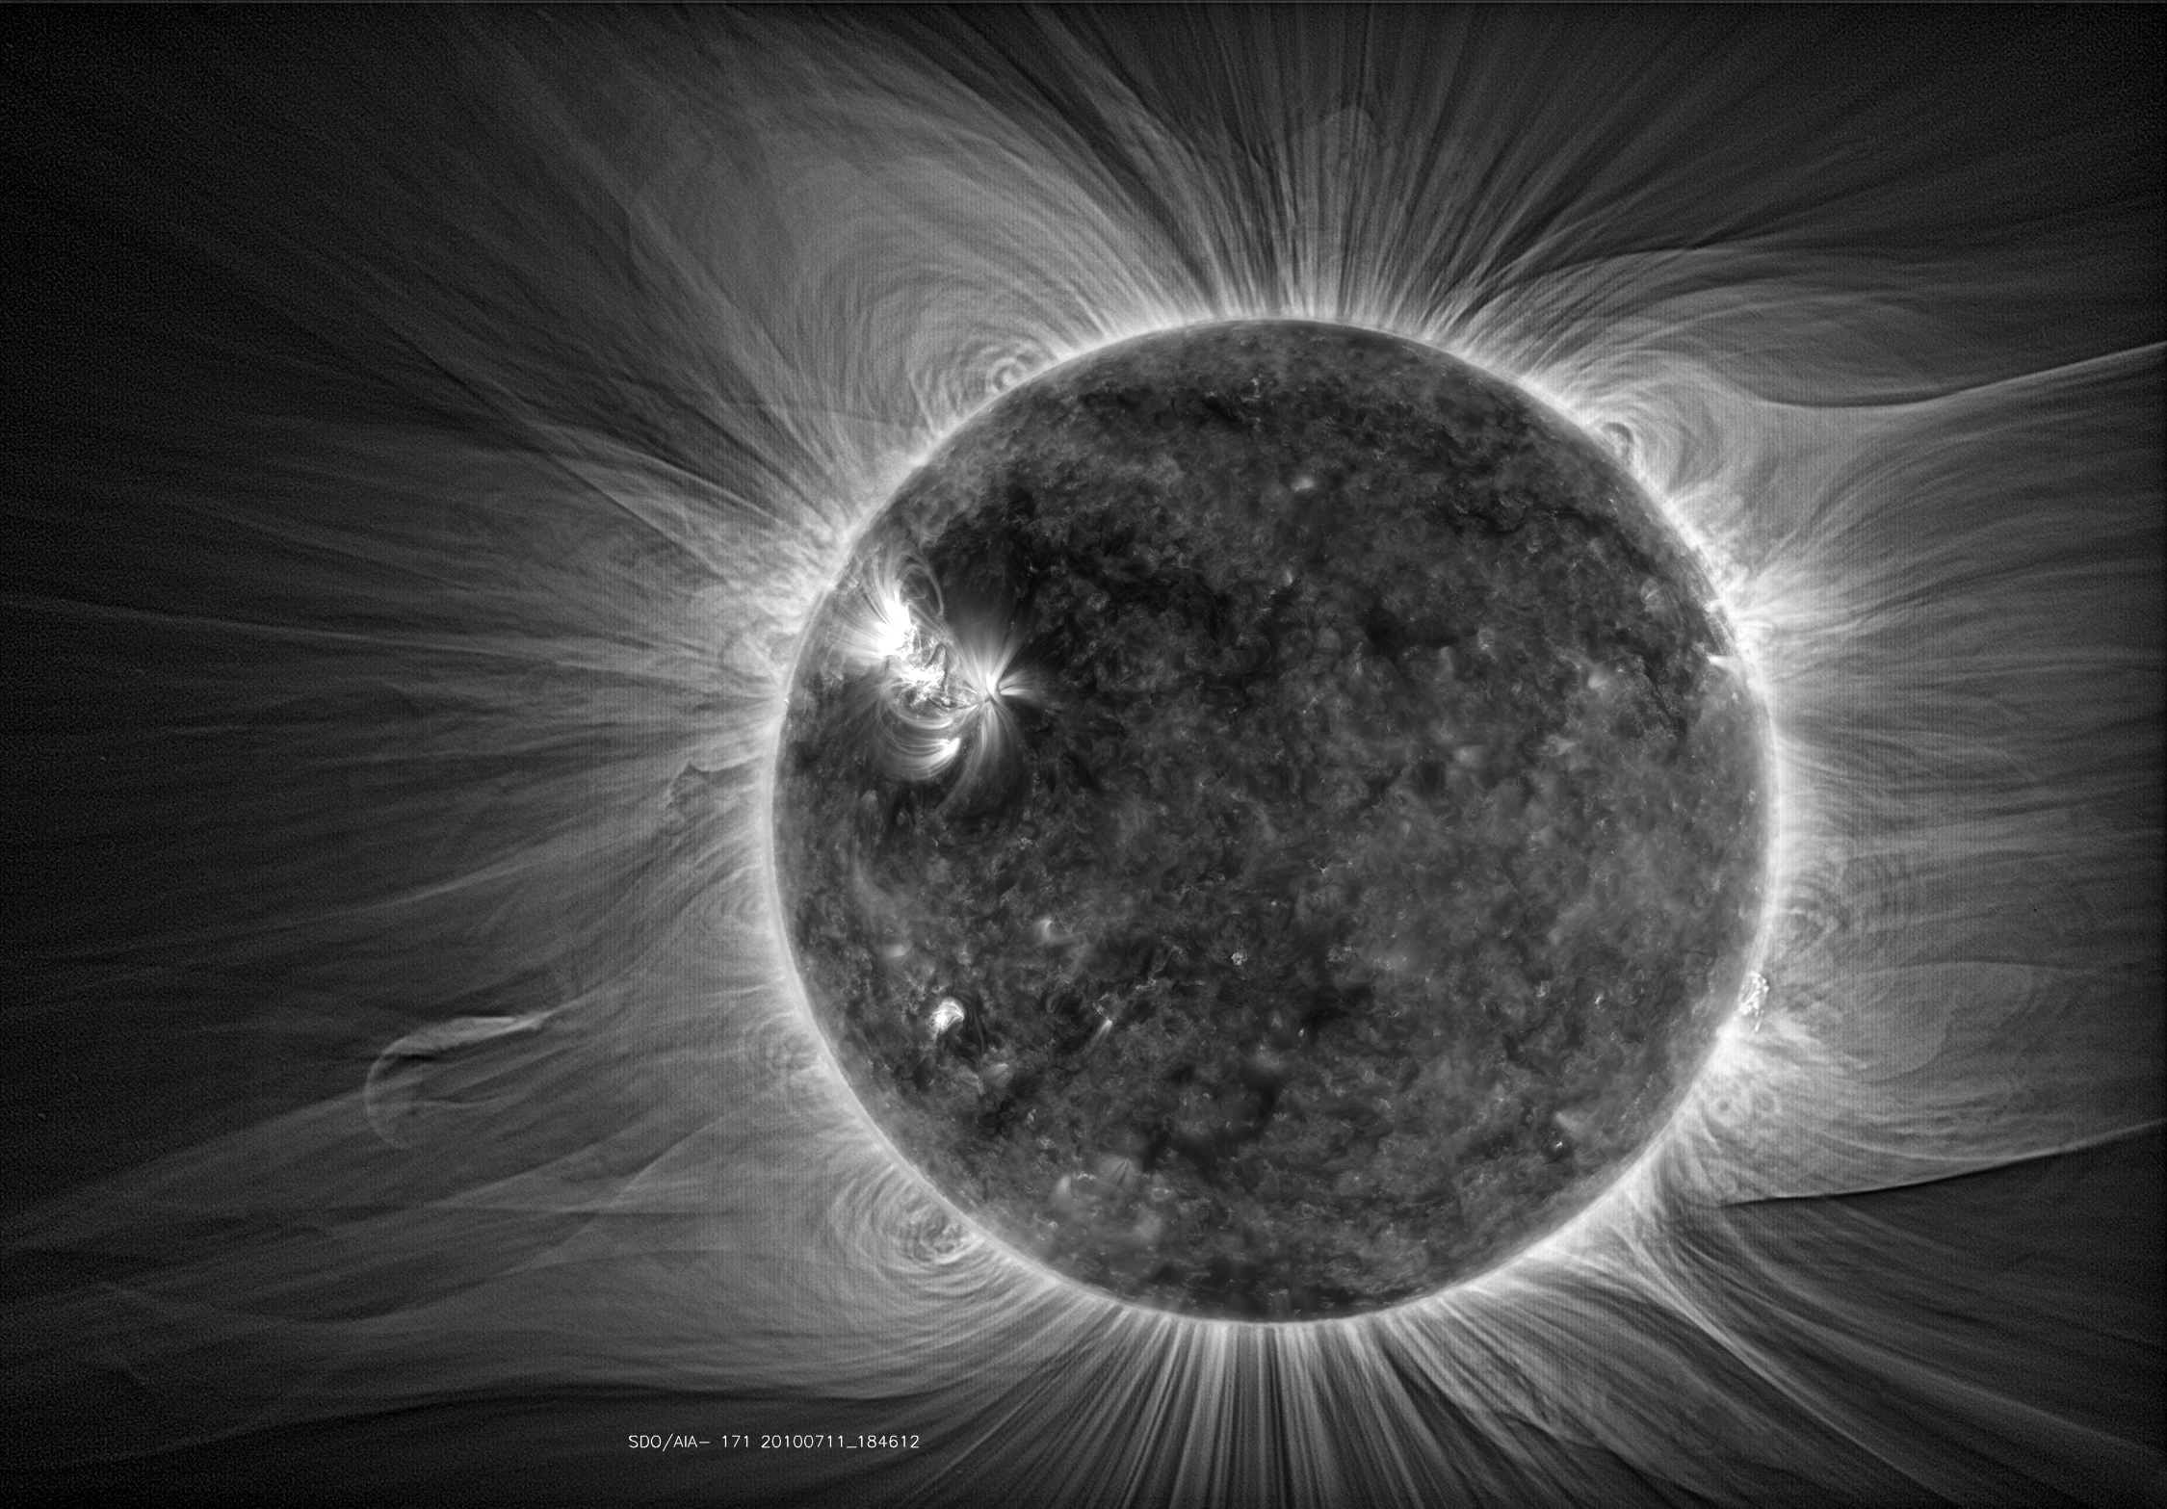
On the Energy Flux of Alfvén Waves Research Update
Tahlina Borradaile, supervised by Yeghiazar Taroyan
5 June 2024
Notes:
Image source:
doi:10.1088/0004-637X/793/2/119

Slide 2
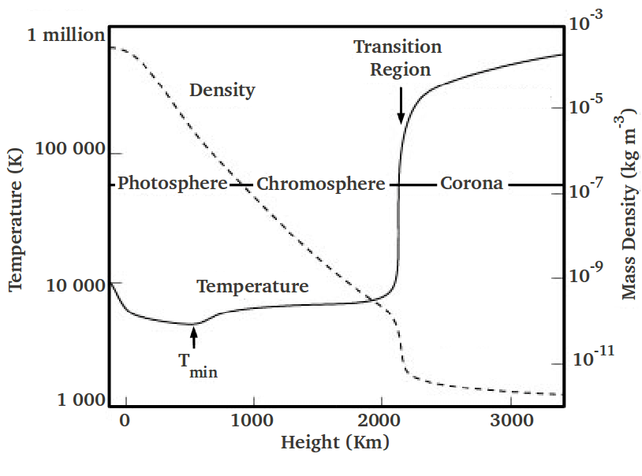
Implications of Alfvén Waves
Thought to be drivers of Chromospheric spicules and the solar wind.
Believed to be important carriers of energy from solar interior to exceptionally hot corona.
The Sun’s hot corona has been a mystery puzzling physicists for many years.
Alfvén waves are one of the candidates for causing coronal heating, nanoflares and magnetic reconnection are others.
Notes:
- Why study AWs?
- Drivers of spicules and the solar wind.
- Believed to be important carriers of energy from the solar interior to the corona.
- The suns hot corona has been a mystery puzzling physicists for many years.
- AWs are one of the candidates for causing coronal heating - inc nanoflares and reconnection.

Slide 3
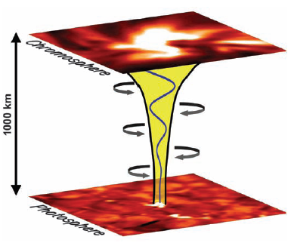
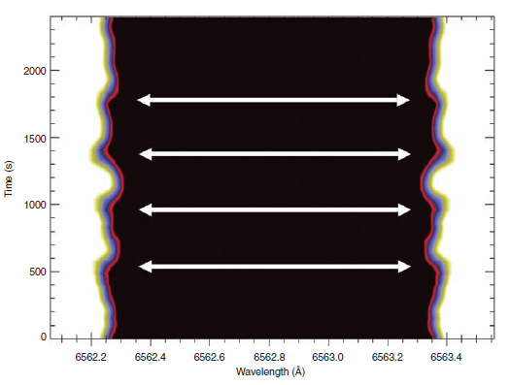
Observations of Alfvén Waves
Confirmed to exist in the solar atmosphere in magnetic flux tubes by Jess et al. (2009) and others.
They saw simultaneous blue and red shifts, indicating non-thermal line broadening of spectral profile.
If transmission coefficient at the transition region is 42%, energy is sufficient to heat corona.
Notes:
- The existence of AWs in the solar atmosphere was purely theorised.
- Jess et al was one of the first studies to provide this observational evidence.
- Shown that on an expanding flux tube from the photosphere to the chromosphere, a torsional Alfvenic perturbation occurs.
- It is noted that if the transmission coefficient at the transition region is 42% of the estimated flux of these waves, the energy would be sufficient to heat the solar corona.

Slide 4
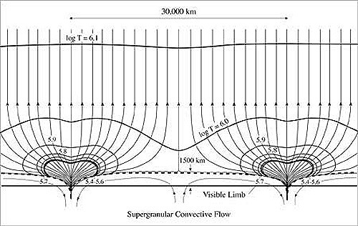
Alfvén Wave Reflection
Shown to theoretically have very strong reflection at TR at low frequencies.
Less at high frequencies, but these are shown to be damped.
Discrepancy between theory/ observation
Studied in 70/80s Hollweg, Musielak, more recently Soler et al. and Tasp and Kopolova.
Uniform field lines or thin flux tube approximation used (uniform field with decreasing density).
At the time this simple picture of the solar atmosphere was all that was known.
Lang, Tufts Uni
Notes:
- That leads us onto the topic of AW reflection.
- Shown to theoretically have strong reflection at the transition region at lower frequencies.
- However, higher frequencies are damped by a variety of mechanisms.
- So, the question stands, if Alfven waves are seen propagating into the solar corona, how do they get there?
- A lot of the work done on Alfven wave reflection was done in the 70s and 80s.
- Studies rely on a single assumption, that the Alfven waves are travelling along field lines that are either uniform, or part of a thin flux tube, as was the assumed reality in earlier research.

Slide 5
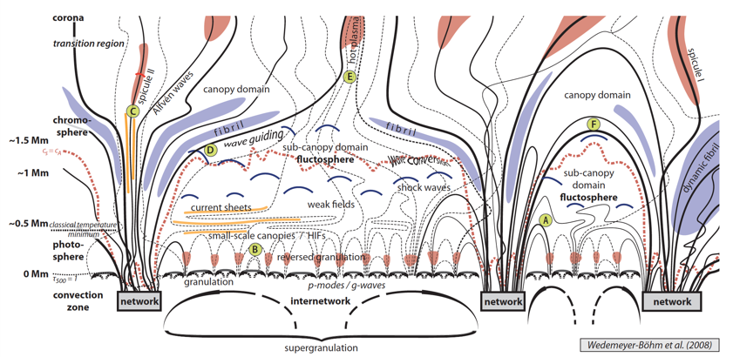
Divergent Field Lines
Wedemeyer-Böhm et al. (2008)
More recent years, picture of solar atmosphere is more complex.
Oversimplification affecting results – highly divergent field lines neglected.
Notes:
- Recently the picture of field lines in the solar atmosphere has become more complex.
- With field lines shown to diverge when approaching the transition region.
- It could be possible that this oversimplification in geometry could be drastically affecting results.
- Highly divergent field lines are neglected.

Slide 6
Study One
Steady state, time-independent regime
Notes:
- Study one is a study of waves in a steady state time-independent regime

Slide 7
Aims & Method
Aim: To create a model accounting for different divergent field geometries.
Hypothesis: Behaviour of wave reflection is different at different field divergencies, reflection disappears at some geometry.
We have derived a set of equations utilising a Klein-Gordon equation.
Three cases will be considered – two degenerate and one more general.
Case I is degenerate and represents the uniform field/thin flux tube scenario – where field lines do not diverge.
Case II is degenerate and represents a scenario with extremely divergent field lines.
Case III represents a general divergence scenario.
Degenerate: (adjective)
mathematics: being simpler (as by having a factor or constant equal to zero) than the typical case
Notes:
- Aim to create a model that takes into account these different field geometries.
- Hypothesis: Behaviour of wave refection is different at different field divergencies, with reflection disappearing at some geometry.
- We have derived a set of equations utilising a Klein-Gordon equation and three cases will be examined.
- Two of these cases are degenerate, meaning a factor of their governing equations are set to zero, for us it is their cut off frequencies.
- Case I is degenerate and represents the uniform field/thin flux tube scenario – where field lines do not diverge, heavily based on Hollwegs work on the subject.
- Case II is degenerate and represents a scenario with extremely divergent field lines.
- Case III represents a general divergence scenario.

Slide 8
Key Equations
Equations of motion and induction in local curvilinear coordinates:
→ velocity perturbation
→ background magnetic field
→ magnetic field perturbation
→ magnetic permeability
→ distance from flux tube axis (radius)
→ height above photosphere (direction of propagation)
→ time
Notes:
- So our key equations are the linearised MHD equations of motion and induction in local curvilinear coordinates.
- Our v_phi and b_phi quantities represent the velocity and magnetic field perturbations.
- Bs represents our background magnetic field
- mu_0 represents our magnetic permeability
- r represents the field lines distance from the flux tube axis (radius).
- s represents the height above the photosphere (the direction of propagation).
- t is time.

Slide 9
Klein-Gordon Equations for Alfvén Waves
Can be combined to derive a Klein-Gordon equation:
$$\frac{∂^{2}Q_{i}}{∂t^{2}}−c_{A}^{2}\frac{∂^{2}Q_{i}}{∂s^{2}}+Ω_{i}^{2}Q_{i}=0$$
$$Q_{1}=A\frac{v_{φ}}{r}$$
Represents velocity perturbation
$$A^{2}={B_{s}r}^{2}$$
Where:
$Ω_{1}$, $Ω_{2}$ are the cut-off frequencies.
$$Q_{2}=\frac{c_{A}}{A}rB_{φ}$$
Represents magnetic field perturbation
$Ω_{1}=0$ in case I, and $Ω_{2}=0$ in case II – these have 100% reflection at low frequencies.
Notes:
- Equations of motion and induction can be combined to derived a Klein-Gordon equation for Alfven waves, where i can be 1 or 2.
- Where Q1 represents the velocity perturbation.
- Q2 represents the magnetic field perturbation.
- Omega 1 and 2 are the cut off frequencies and are set to 0 in our two degenerate cases,
- These will have 100% reflection at low frequencies.

Slide 10
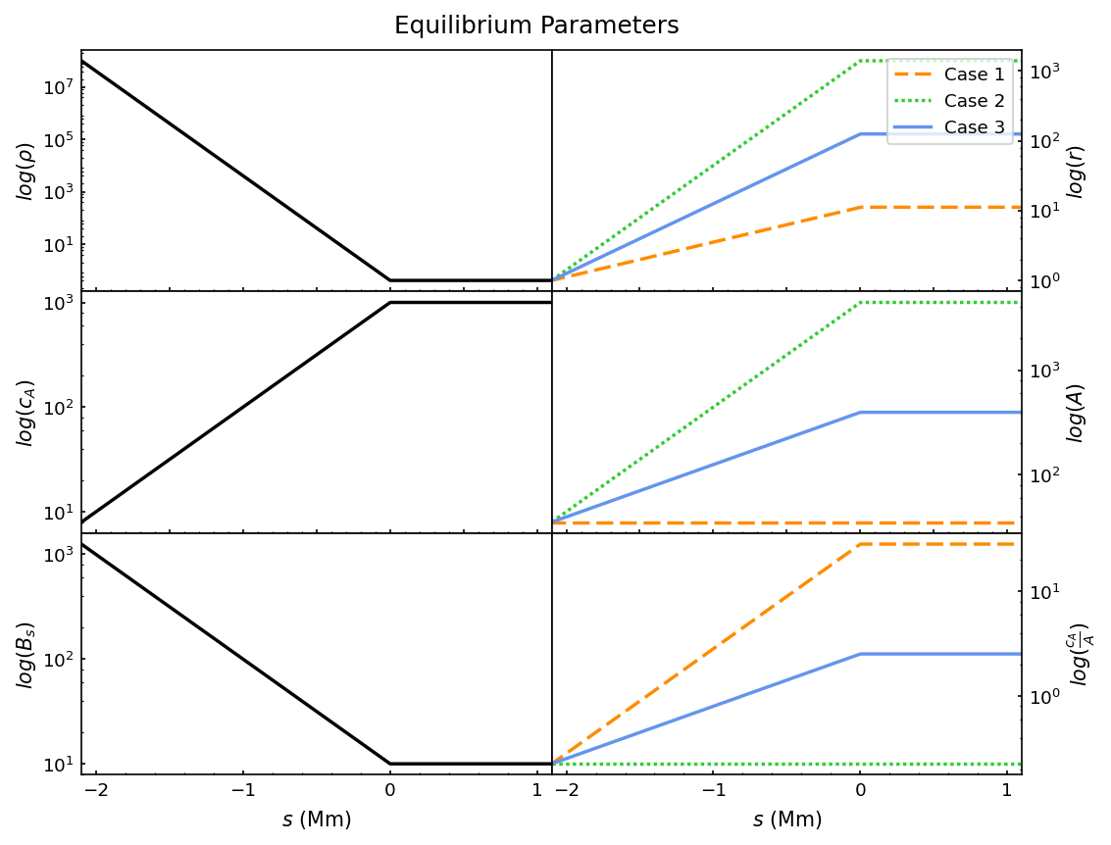
Plasma Regime
$$Case 2$$
$$Case 1$$
Corona
$$Case 3$$
Interface
$$s=0$$
(Transition region)
$$r$$
Chromosphere
Density, Alfvén speed, and background magnetic field constant across cases.
Flux tube expansion is varied between cases → Case 2 has the greatest.
Degenerate cases correspond to 100% reflection at low frequencies
Notes:
- So for our plasma regime, our spatial solutions are plotted between s=-2Mm and 1Mm, where the coronal base lies at s=0.
- Our 3 cases represents 3 different geometries, where case 1 is a thin flux tube and its radius r increases by 1 order of magnitude.
- Case 2 is a highly divergent flux tube, which increases by 3 orders of magnitude.
- And case 3 is a general divergent flux tube, which increases by 2 orders of magnitude.
- Our Bs, rho and Alfven speed all have these exponential profiles, but are constant across the 3 cases.
- A constant scale height h is used in our exponents, which is quite restricting, as naturally this would vary with height as temperature varies.

Slide 11
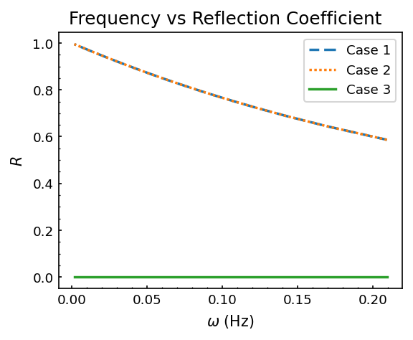
Reflection
Case 1 and 2 have the same reflection profile over different wave frequencies.
Case 3 has no reflection.
$$R=\frac{{\left|b\right|}^{2}}{{\left|a\right|}^{2}}$$
$$→\frac{b}{a}=−\frac{H_{0}^{(1)}−iH_{1}^{(1)}}{H_{0}^{(2)}−iH_{1}^{(2)}}$$
Notes:
- To start with our reflection coefficient is plotted for the 3 cases for waves with time periods from 30s to 1hr.
- We used the same coefficient as used by Hollweg.
- This is given by this equation, representing ratio of down-going to upward-going wave flux, using combination of Bessel functions.
- These functions consider the scale height, frequency and the alfven speed.
- Our general case 3 is derived to have 0 reflection, which is also shown here.
- Cases 1 and 2 follow the same profile, with much higher reflection at lower frequencies.

Slide 12
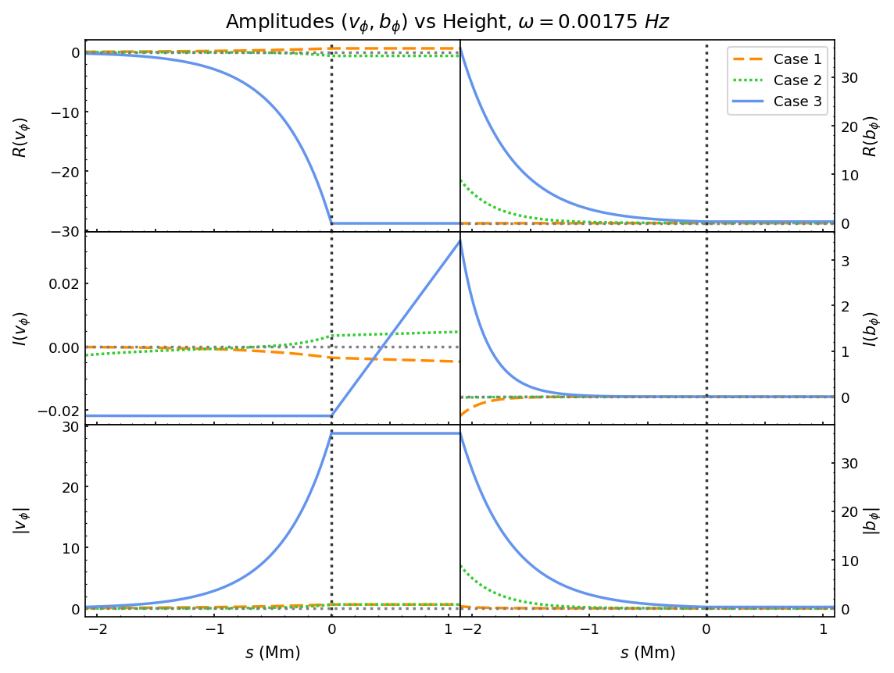
Low
Frequency
Wave
$ω=1.75 mHz$
$τ=10 m$
Case 3 shows largest velocity and magnetic field perturbation.
No oscillations
Notes:
- In our study we specifically look at 2 separate waves, a low frequency wave, and a high frequency one.
- These results represent a steady state solution in time.
- Our low frequency wave corresponds to a wave with an oscillation period of 10 minutes.
* explain visuals of spatial profile graph.
- Velocity and magnetic field perturbations are characterised by a continuous increase/decrease between the photosphere and coronal base, showing no oscillations.
- Case 3 has largest increase in velocity perturbation.
- Cases 1 and 2 end up at the same values at the coronal base, but their values in the lower region vary.

Slide 13
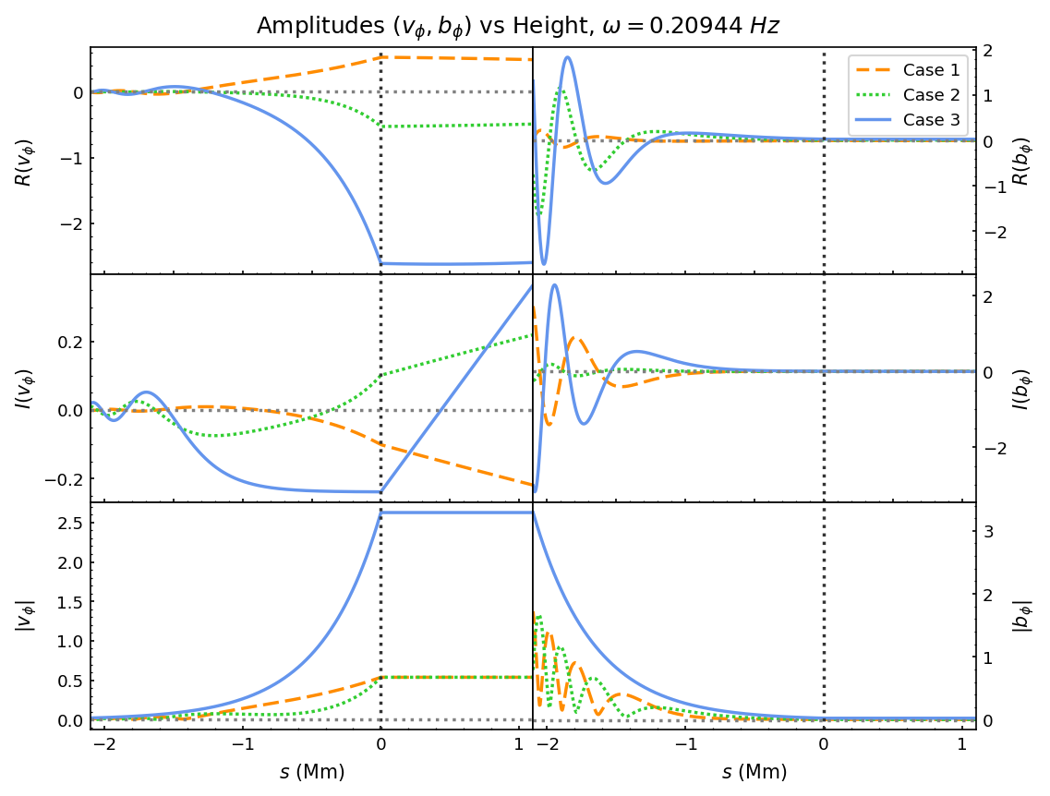
High
Frequency
Wave
$ω=209 mHz$
$τ=30 s$
Case 3 shows largest velocity and magnetic field perturbation, but less of a difference than low frequency case.
Oscillations
Notes:
- Our high frequency case corresponds to a wave with an oscillation period of 30s.
- We can see the same behaviour as in the low frequency oscillation.
- However there is less of a difference between case 3 and the others.
- We now see oscillatory behaviour in the curves - which is due to the higher frequency.
- Our case 3 magnitudes do not show oscillations as the real and imaginary components are out of phase

Slide 14
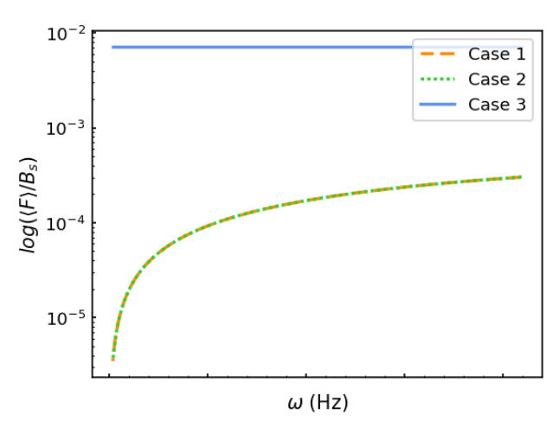
Time Averaged Flux
Flux in case one and two is dependent on frequency, with flux tending to zero at low frequencies.
Case three has the same flux, regardless of frequency, due to no reflection.
Notes:
- We plotted the fluxes for various frequency waves for periods of 30s to 1 hr.
Flux in case one and two is dependent on frequency, with flux tending to zero at low frequencies.
Case three has the same flux regardless of frequency, due to no reflection.
- Significantly higher flux in case 3 at lower frequencies compared to other cases, which have the same fluxes due to them sharing a reflection coefficient.

Slide 15
Conclusions & Consequences
Conclusion:
Lower frequency waves reach 100% reflection when either of the governing Klein-Gordon equations is degenerate and cut-off frequency vanishes.
The flux is supressed in degenerate cases.
Non-degenerate cases can reach 100% transmission at certain complex geometries, especially at lower frequencies.
Consequences:
Indication that Alfvén waves at certain complex divergent geometries can successfully penetrate the transition region, carrying energy into the solar corona.
Notes:
- Lower frequency waves reach 100% reflection when either of the governing Klein-Gordon equations is degenerate and cut-off frequency vanishes.
- The flux is supressed in degenerate cases.
- Non-degenerate cases can reach 100% transmission at certain complex geometries, especially at lower frequencies.
- Theres an indication that Alfvén waves at certain complex divergent geometries can successfully penetrate the transition region, carrying energy into the solar corona.

Slide 16
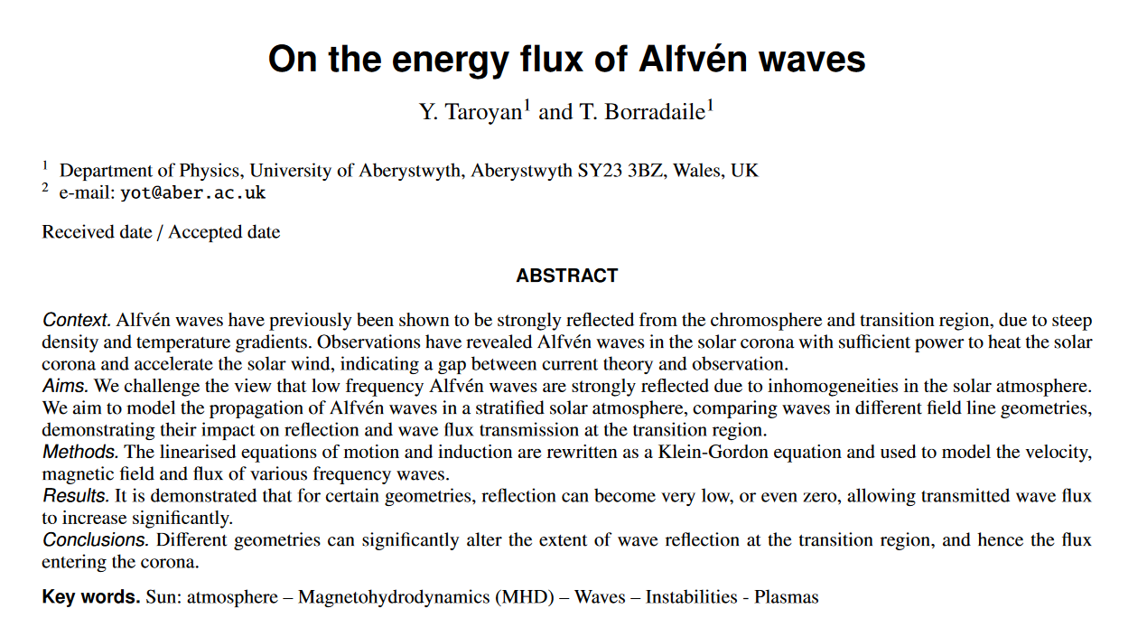
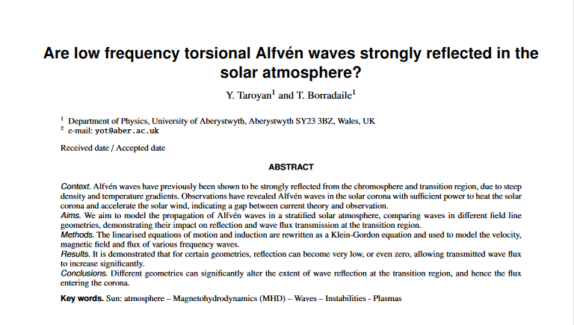
Paper:
D R A F T
Almost ready for submission!
Notes:
- Publish this work, the paper is almost finished, submit soon!

Slide 17
Study Two
Driven time-dependent regime
Notes:
Wave driven time-dependent regime

Slide 18
Aims & Method
Aim: To create a model accounting for different divergent field geometries in a time dependent system with various wave drivers.
Hypothesis: Transmitted energy flux is different at different field divergencies, and dependent on the wave driver used and other background quantities.
Method: Numerical techniques will be used to simulate Alfvén waves in a stratified solar atmosphere by solving the equations of motion and induction.
Notes:
- Aim: To create a model accounting for different divergent field geometries in a time dependent system with various wave drivers.
- Hypothesis: Transmitted energy flux is different at different field divergencies, and dependent on the wave driver used and other background quantities.
- Method: Numerical techniques will be used to simulate Alfvén waves in a stratified solar atmosphere by solving the equations of motion and induction.

Slide 19
Key Equations
Equations of motion and induction in local curvilinear coordinates:
→ velocity perturbation
→ background magnetic field
→ magnetic field perturbation
→ magnetic permeability
→ distance from flux tube axis (radius)
→ height above photosphere (direction of propagation)
→ time
Notes:
- Again our key equations are the equations of motion and induction, but this time rather than solving these analytically for a steady state, we will solve these directly using numerical techniques.

Slide 20
Numerical Scheme
Equations of motion and induction in local curvilinear coordinates:
Time-dependent 1st order hyperbolic coupled PDE system
Finite-difference method
Notes:
So as part of my modules required for the phd, I chose to do a third year maths module on numerically solving partial differential equations.
This helped me familiarised myself with the required terminology and methods that are needed in solving PDEs
During this I was able to identify my scheme as being a time-dependent 1st order hyperbolic coupled PDE system.
This has implications for what types of numerical scheme should be used to solve the system.
Usually this type of PDE is solved using a finite difference scheme, which work best with wave like equations

Slide 21
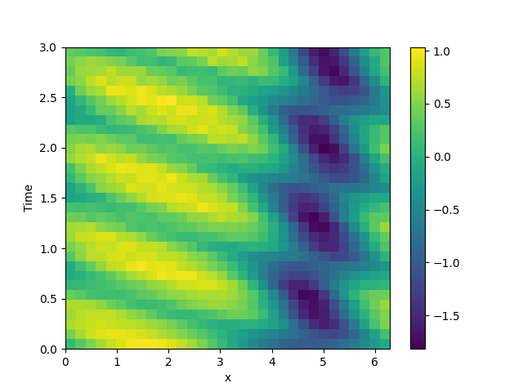
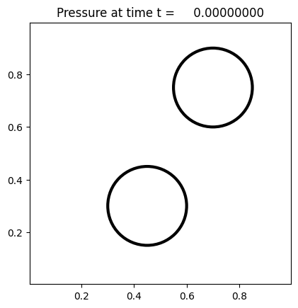
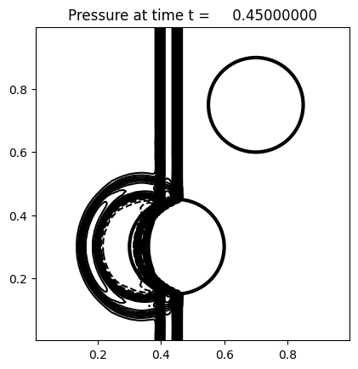
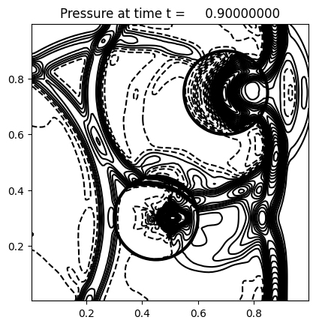
PDE Solvers in Python?
Clawpack example: Acoustic wave scattered by two cylinders
Py-pde example:
Kortweg-de Vries Equation
Notes:
- However this 3rd year module only covered single equations so we set out on the task of finding a suitable prewritten PDE solver in python, just like there is in IDL.
A lot of solvers are specifically designed to use finite volume techniques, which aren’t appropriate for this.
We first started with py-pde, which solves equations using a combination of the method of lines and the finite difference method.
We tested this for quite some time, but were struggling with boundary conditions and stability.
After a few weeks of trying to figure this out, we decided it would be best to try a different package – Clawpack.
It promised a lot and had some very beautiful examples and animations, and a quick run time.
So after getting a virtual linux machine installed (twice, because it stopped working)
After some beautiful tests we realised that it only written for a predefined set of equations and constant coefficients
Varying our coefficients through space and time was only possible through writing a whole new solver for the equations – in fortran!
So after some very despondent days of wondering if I was ever going to get this working, and looking at other solvers, all of which are so complex they need several weeks to learn the basics –
I started tinkering with py-pde again after a short conversation with Tom about boundary conditions during demonstrating.
Low and behold, I managed to get some better results using these suggestions.

Slide 22
Simplifying
Equations of motion and induction in local curvilinear coordinates:
Simplify
Where:
$$v=\frac{V_{φ}}{r}, b=r B_{φ}$$
$$c1=\frac{B_{s}}{μ_{0}r^{2}ρ}, c2=r^{2}B_{s}$$
$$\frac{∂v}{∂t}=c1\frac{∂b}{∂x}, \frac{∂b}{∂t}=c2\frac{∂v}{∂x}$$
Notes:
-So just to take you through my work with py-pde,
To start with I needed to simplify the equations as much as possible to learn the package and make sure the implementations were behaving as expected.
First I simplified the equations so that we’re left with just a pair of coupled equations with two variables and two coefficients.

Slide 23
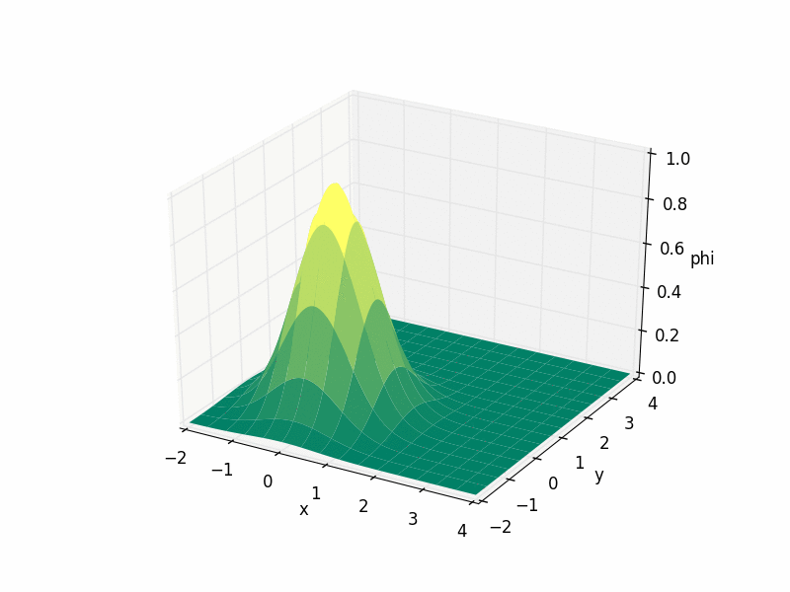
Advection
$$\frac{∂v}{∂t}=c1\frac{∂b}{∂x}, \frac{∂b}{∂t}=c2\frac{∂v}{∂x}$$
2D advection, where $u$ is solenoidal
$$\frac{∂u}{∂t}=−w\frac{∂u}{∂x}$$
Where:
$w→$ wind
$u→$ velocity field
Advection: (noun)
physics: the usually horizontal movement of a mass of fluid (such as air or ocean current)
Notes:
- These equations are very similar to the 1D advection equation, so I simplified this even further, and moved from a coupled system to a single equation system.
- Advection is defined as the mass movement of fluid, here our constant is referred to as wind, and u is the velocity field.

Slide 24
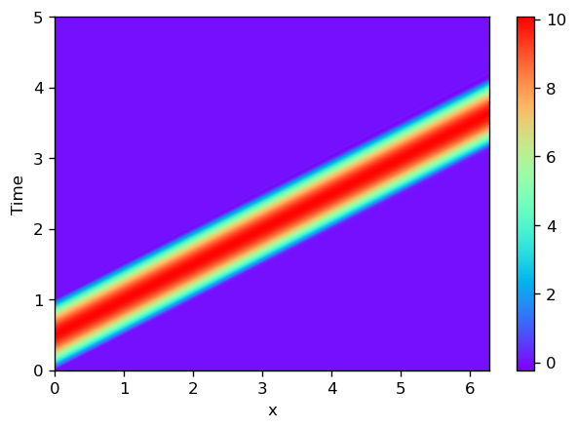
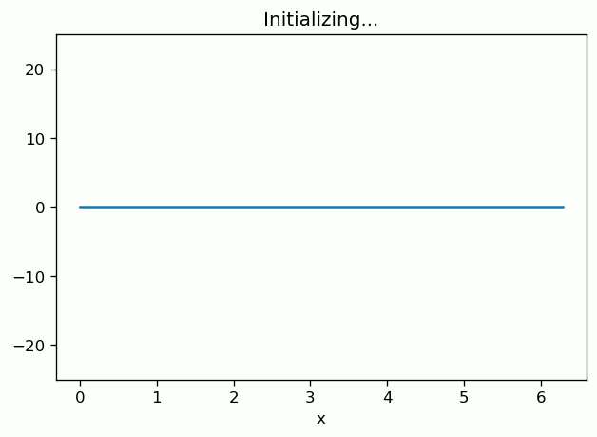
Development in py-pde - advection
$$\frac{∂u}{∂t}=−w\frac{∂u}{∂x}$$
Notes:
- With py-pde,
I started by running some of their examples, and then implemented my own simple advection system, with a pulse driver.
This is a relatively stable example with the expected behaviour at the boundary.

Slide 25
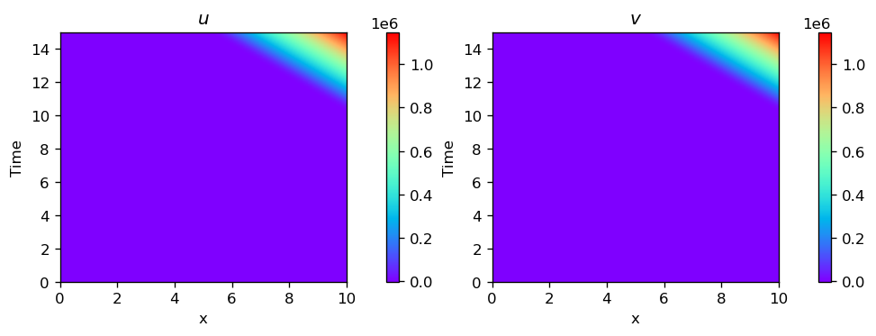
Development in py-pde – coupled advection
$$\frac{∂u}{∂t}=c\frac{∂v}{∂x}, \frac{∂v}{∂t}=c\frac{∂u}{∂x}$$
Notes:
I decided to tried to implement the coupled set of equations,
This caused a massive instability, causing infinite values very quickly.

Slide 26
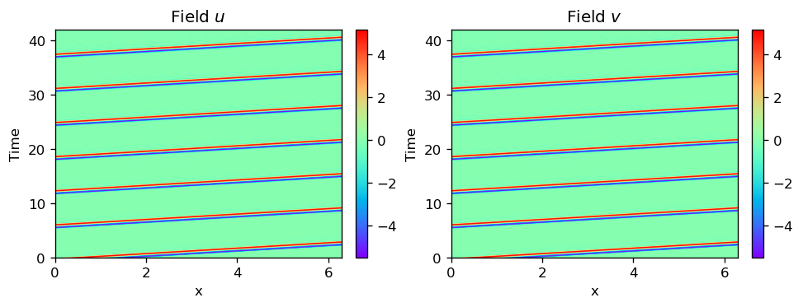
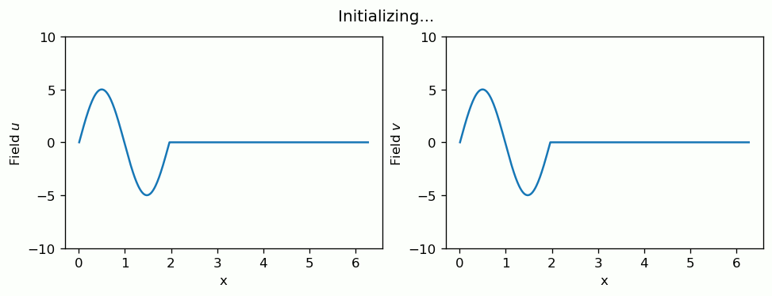
Development in py-pde – coupled advection
$$\frac{∂u}{∂t}=c1\frac{∂v}{∂x}, \frac{∂v}{∂t}=c2\frac{∂u}{∂x}$$
Notes:
Eventually I managed to fix this with tweaking of the conditions in the code
The second issue we ran into was this which is the waves appearing to reflect back even when the right hand boundary is apparently open –
This is about the point we tried pyclaw, as we weren't able to puzzle out why exactly this behaviour was happening.

Slide 27
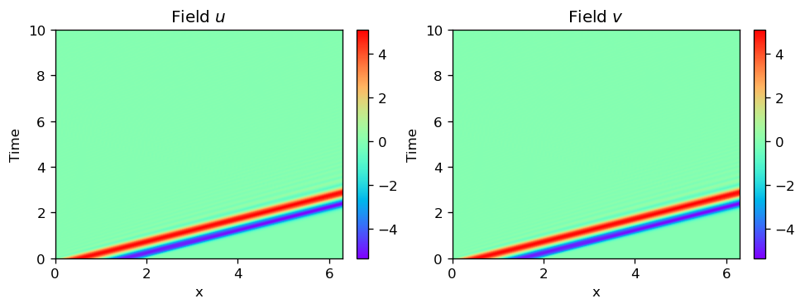
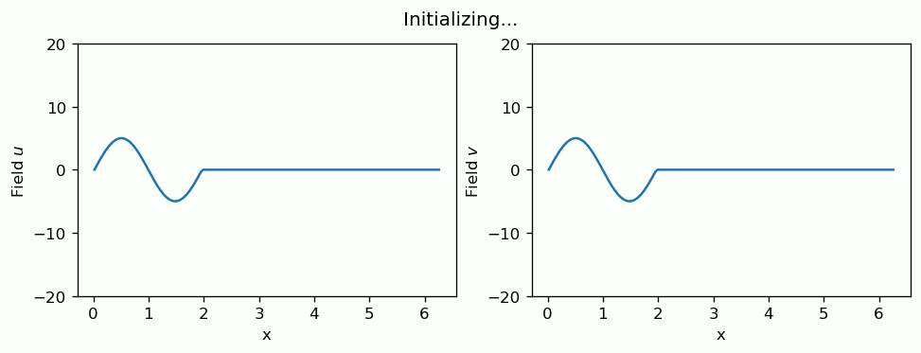
Development in py-pde – coupled advection
$$\frac{∂u}{∂t}=c1\frac{∂v}{∂x}, \frac{∂v}{∂t}=c2\frac{∂u}{∂x}$$
Boundary conditions:
LH: $u, v = 0$
RH: $\frac{d^{2}}{{d x}^{2}}=1$
Notes:
So after some time spent trying to get linux installed as a virtual machine and then trying to get clawpack to work. I returned to py-pde.
The main change here is setting the boundaries to be zero on the LHS
Constant second derivative of 1 on the right,
Which produces this behaviour of the wave clearly exiting the system and not returning.

Slide 28
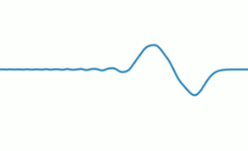
Development in py-pde – Wiggles..?
Numerical Stability:
The Courant-Friedrichs-Lewy Condition
CFL condition $→$ critical stability criterion
$$c\frac{Δt}{Δx }≤CFL number (usually 1)$$
Where:
$c→$ wave speed
$Δt→$ time step size
$Δx→$ spatial step size
For wave equations, to meet the CFL condition, we need:
$$Δt ≤\frac{Δx}{c}$$
Wiggles
Notes:
My current focus is on the apparent wiggles that appear in the results as the waves propagate.
I’m trying to identify their cause and get rid of them or at least minimise them.
Appear to be related to numerical stability – which I’ve been looking into –
One of the concepts I’ve come across is the CFL condition, which explains how the stability is related to the time step, spatial step and the wave speed.
This will be one of my next steps in investigating stability of my code and identifying the cause of these wiggles, as they can be quite pronounced sometimes.

Slide 29
What’s next?
Maintain stability
Increase complexity of equations
Implement individual coefficients ($B_{s}, μ_{0}, ρ, r)$
Vary these coefficients in space
Implement $r$ in the spatial derivatives (so true $V_{φ}$ and $B_{φ}$ can be found)
Investigate the impact of varying initial values on $V_{φ}$ and $B_{φ}$
Calculate the flux using the values of $V_{φ}$ and $B_{φ}$ at the coronal base
Investigate the dependent of $r$ on transmitted energy flux
Notes:
- So presuming I manage to get a stable code, the next steps are increasing the complexity.
- Firstly this will be implementing variable coefficients for the background quantities.
Implement the r inside the spatial derivatives.
- Investigate how the system behaves with different values of these.
Coefficient r dictates the profile of the flux tube a wave propagates though.
This is where we continue to investigate the effect geometry on transmitted energy flux, which will be calculated by the values of V and B at the coronal base.

Slide 30
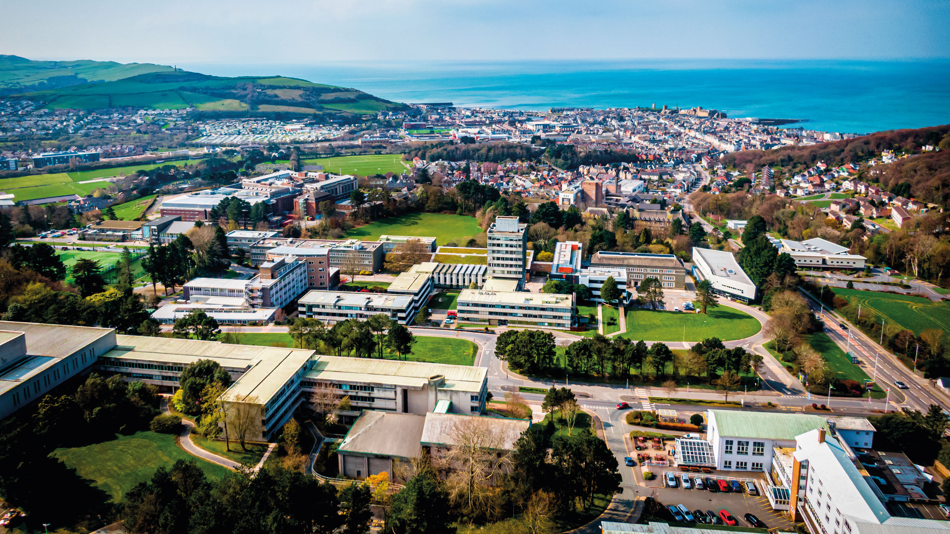
Summary:
Alfvén waves can play an important role in heating the solar atmosphere and solar wind acceleration, with recent observations revealing strong upward flux of Alfvén waves.
Previous studies have demonstrated strong reflection of waves at the transition region, but use models representing degenerate cases in the Klein-Gordon equation.
The Klein-Gordon equation is used to investigate different geometries of field lines.
Field line geometry can have a great impact on transmission of Alfvén waves into the corona, reaching 100% in certain cases, allowing large fluxes to be carried to the corona.
Numerical techniques are being used to simulate the time-dependent behaviour of Alfvén waves in the solar atmosphere using py-pde.
Tahlina Borradaile
tab22@aber.ac.uk
Room 3.13
users.aber.ac.uk/tab22
Key References:
Hollweg (1984)
Jess et al. (2009)
MHD waves in the solar atmosphere (Roberts)
Taroyan et al (2021)
Wedemeyer-Böhm et al. (2008)
Notes:
- In summary:
Alfvén waves can play an important role in heating the solar atmosphere and solar wind acceleration, with recent observations revealing strong upward flux of Alfvén waves.
Previous studies have demonstrated strong reflection of waves at the transition region, but use models representing degenerate cases in the Klein-Gordon equation.
The Klein-Gordon equation is used to investigate different geometries of field lines.
Field line geometry can have a great impact on transmission of Alfvén waves into the corona, reaching 100% in certain cases, allowing large fluxes to be carried to the corona.
Numerical techniques are being used to simulate the time-dependent behaviour of Alfvén waves in the solar atmosphere using py-pde.

