Slide 1
Reflection of Alfvén Waves in the Solar Atmosphere
Research Update
Tahlina Borradaile
Supervised by Youra Taroyan

Slide 2
Introduction to MHD Waves
MHD waves are characterized by two fundamental speeds – governed by plasma properties.
The Alfvén speed and the sound speed:
Preferred direction of propagation dependent of wave type.
Slow and Alfvén waves - along magnetic field.
Fast waves - perpendicular to magnetic field.
Notes:
-MHD waves are characterised by two fundamental speeds, the Alfven speed and the sound speed, which are characterised by the plasma’s properties.
-So, in a plasma with a constant density (rho), and a constant pressure (P), the plasma has an embedded uniform magnetic field (B0), which has an adiabatic index (gamma), and a magnetic permeability (mu).
-In a plasma with a magnetic field in equilibrium, a preferred direction of propagation is defined for the sound waves – this is known as an anisotropic medium.
-So, waves in a magnetic medium have a preferred direction of propagation which is determined by the type of wave – which for slow and Alfven waves is along the magnetic field, and for fast waves is perpendicular to the field.

Slide 3
Lorentz Force
Compression to plasma – sound waves propagate along field.
Disturbance to field lines – oscillation induced by Lorentz force.
Lorentz force governed by tension and pressure forces – acts perpendicular to magnetic field.
Lorentz force
Pressure force
Tension force
Notes:
-In a plasma with a constant magnetic field strength and direction – any compression to the plasma results in a sound wave propagating.
-If a disturbance occurs that does not compress the plasma, but rather perturbs the magnetic field lines, the bent field lines cause the magnetic field to generate a current to attempt to restore equilibrium.
-This is known as the Lorentz force.
-As a result, an oscillation is induced – like a wave on a string.
-This Lorentz force generates both tension and pressure forces and acts in the direction perpendicular to the magnetic field.
-The Lorentz force is governed by this equation (J x B), where the first term represents the magnetic pressure force and the second term represents the tension force.
-Here, B0 represents the background field, whereas Bz and B represent wave perturbation quantities.

Slide 4
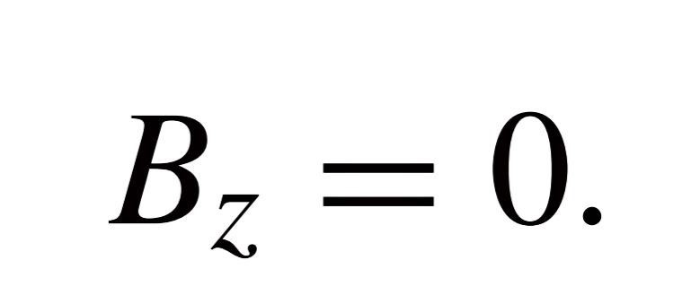
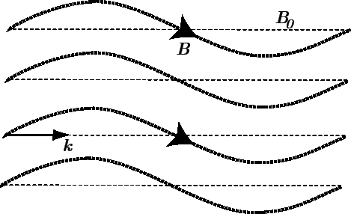
Alfvén Waves
If no compressive forces arise:
Only tension force acts:
Resulting oscillation is an Alfvén wave.
Speed of wave on a string:
Lorentz force
Pressure force
Tension force
Alfven speed:
Fitzpatrick, U.O. Texas.
Notes:
-If no compressive forces arise – hence Bz = 0, only the tension force acts, the resulting oscillation is an Alfven wave.
-They propagate at the familiar speed of a wave on an elastic string.
-In the case of an Alfven wave – the tension force is B0^2/mu per unit length of field, in a volume with density rho_0, this is our Alfven speed.

Slide 5
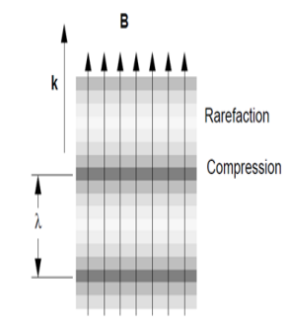
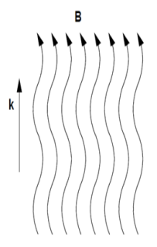
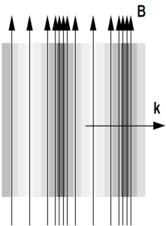
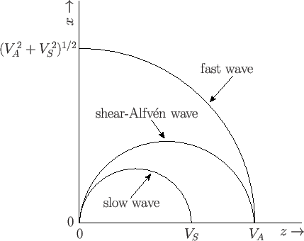
Propagation of MHD Waves
Alfvén wave
Any phase speed except 90$°$ to $B_{0}$
Group velocity parallel to $B_{0}$
Transverse
Slow wave
Parallel to $B_{0}$
Longitudinal
Fast wave
Perpendicular to $B_{0}$
Phase diagram
Magnetic field in $z$ direction
Notes:
-For disturbances that compress the plasma, when the magnetic pressure force and the tension are acting in unison, this is a fast magnetoacoustic wave, and when they act in opposition – this is a slow magnetoacoustic wave.
-In a uniform medium – Alfvén waves propagate with a phase speed in any direction – except for 90* to the magnetic field.
-However their group velocity is strictly parallel to magnetic field lines, hence energy is transported strictly along field liens.
-Slow waves are longitudinal waves that propagate parallel to B0, and fast waves propagate perpendicular to B0.
-Phase diagrams show the phase velocities of MHD modes.
-Slow waves, have the smaller phase velocity, and fast waves the largest.
-Magnetic field lies in z direction.
-These diagrams also neatly show that fast modes are the only modes that can propagate in the direction perpendicular to the magnetic field.

Slide 6
But…
This description of MHD waves is strictly that of waves in a uniform medium.
In a structured medium, such as a flux tube – classification and terminology is modified, as structures act as waveguides.
Due to variations in wave amplitude, dissipation, dispersion in different regions.
MHD wave modes frequently couple.
Some examples of waves in structured medium are:
Surface waves, body waves, sausage waves, and kink waves.
Notes:
-This description of MHD waves is a fairly archaic picture of reality, as it applies only to waves in a uniform medium.
-In a structured medium, such as a flux tube – classification and terminology is modified, as structures act as waveguides.
-In a structured medium, waves can undergo changes in amplitude, dissipation, and dispersion as they propagate
-This is due to variations in wave amplitude, dissipation, and dispersion occurring in different regions, which a wave may be propagating through.
-MHD waves also frequently couple.
-Some examples of waves in structured medium are: Surface waves, body waves, sausage waves, and kink waves.

Slide 7
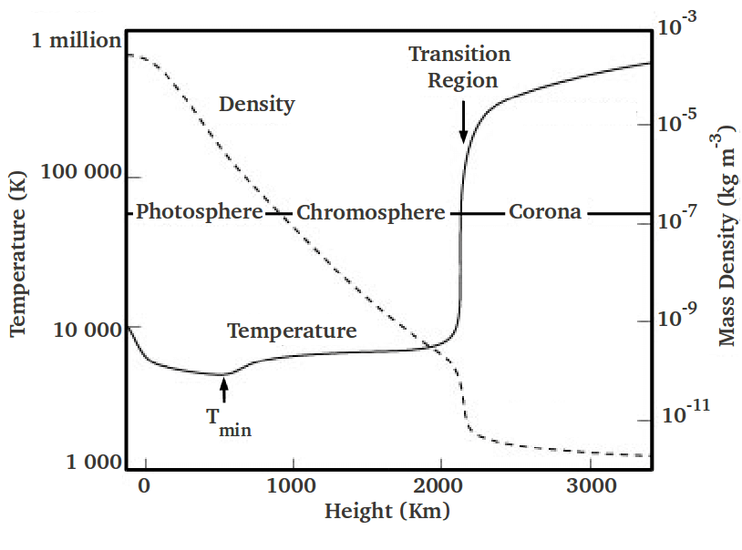
Implications of Alfvén Waves
Thought to be drivers of Chromospheric spicules and the solar wind.
Believed to be important carriers of energy from solar interior to exceptionally hot corona.
The Sun’s hot corona has been a mystery puzzling physicists for many years.
Alfvén waves are one of the candidates for causing coronal heating, nanoflares and magnetic reconnection are others.
Notes:
-Why study Aws?
-Alfven waves are thought to be drivers of chromospheric spicules and the solar wind.
-They are also believed to be important carriers of energy from the solar interior to the corona.
-The suns hot corona has been a mystery puzzling physicists for many years.
-Alfven waves are one of the candidates for causing coronal heating, along with nanoflares and magnetic reconnection.

Slide 8
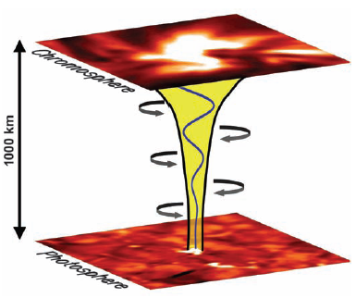
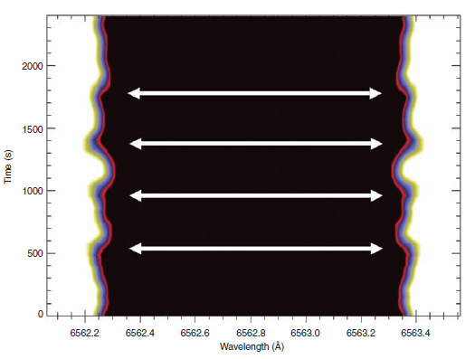
Observations of Alfvén Waves
Confirmed to exist in the solar atmosphere in magnetic flux tubes by Jess et al. (2009) and others.
They saw simultaneous blue and red shifts, indicating non-thermal line broadening of spectral profile.
If transmission coefficient at the transition region is 42%, energy is sufficient to heat corona.
Notes:
-Up until quite recently, the existence of Alfven waves in the solar atmosphere was purely theorised.
-Jess et al was one of the first studies to provide this observational evidence.
-The study uses hydrogen-alpha absorption profiles from the Swedish Solar Telescope to investigate oscillation of 2-11 minutes that we observed in a bright point group.
-They saw simultaneous blue and red shifts, which indicate non-thermal line broadening of the spectral profile.
-It was shown that on an expanding flux tube from the photosphere to the chromosphere, a torsional Alfvenic perturbation occurs.
-This results in the observed oscillations, which are determined to be induced globally.
-Importantly, it is noted that if the transmission coefficient at the transition region is 42%, the energy would be sufficient enough to heat the solar corona.

Slide 9
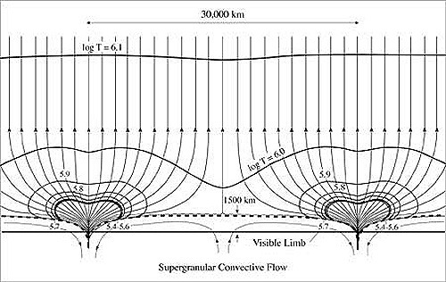
Alfvén Wave Reflection
Shown to theoretically have very strong reflection at TR at low frequencies.
Less at high frequencies, but these are shown to steepen into shocks.
70/80s Hollweg, Musielak, more recently Soler et al. and Tasp and Kopolova.
Uniform field lines or thin flux tube approximation used (uniform field with decreasing density).
At the time this simple picture of the solar atmosphere was all that was known.
Lang, Tufts Uni
Notes:
-Alfven waves have been shown to theoretically have very strong reflection at the transition region at lower frequencies.
-However, higher frequencies are shown to steepen into shocks.
-So, the question stands, if Alfven waves are seen propagating into the solar corona, how do they get there?
-A lot of the work done on Alfven wave reflection was done in the 70s and 80s but authors such as Hollweg and Musielak, as well as more recently like Soler 2017, and Tasp and Kopolova 2021.
-Most of these studies rely on a single assumption, that the Alfven waves are travelling along field lines that are either uniform, or part of a thin flux tube, as was the assumed reality in earlier research.
(simple field lines)

Slide 10
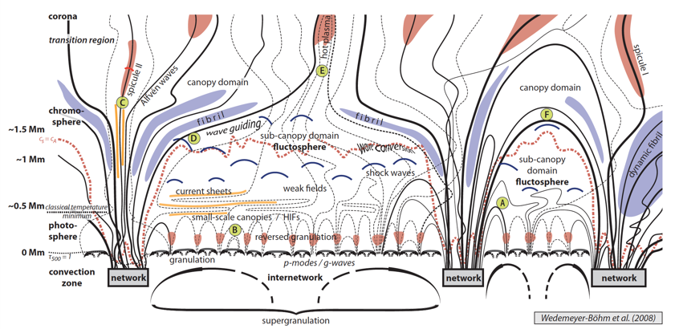
Divergent Field Lines
Wedemeyer-Böhm et al. (2008)
More recent years, picture of solar atmosphere is more complex.
Oversimplification affecting results – highly divergence field lines neglected.
Notes:
-In more recent years, the picture of field lines in the solar atmosphere has become vastly more complex
-with field lines shown to diverge when approaching the transition region (as nicely shown by Wedemeyer-Bohm et al 2008)
-It could be possible that this oversimplification in geometry could be drastically affecting results.
-As the more highly divergent field lines are neglected.
(complex field lines)

Slide 11
Aims & Method
Aim to create a model taking into account different divergent field geometries.
Hypothesis: Behaviour of wave refection is different at different field divergencies, reflection disappears at some angle.
We have derived a set of equations utilising a Klein-Gordon equation.
Three cases will be considered – two degenerate and one more general.
Case I is degenerate and represents the uniform field/thin flux tube scenario – where field lines do not diverge.
Case II is degenerate and represents a scenario with extremely divergent field lines.
Case III represents a general divergence scenario.
Degenerate: (adjective)
mathematics: being simpler (as by having a factor or constant equal to zero) than the typical case
Notes:
-In our study, we aim to create a model that takes into account these different field geometries.
-Hypothesis: Behaviour of wave refection behaves differently at different field divergencies, with reflection disappearing at some angle.
-We have derived a set of equations utilising a Klein-Gordon equation and three cases will be examined.
-Case I is degenerate and represents the uniform field/thin flux tube scenario – where field lines do not diverge.
-Case II is degenerate and represents a scenario with extremely divergent field lines.
-Case III represents a general divergence scenario.

Slide 12
Klein-Gordon Equations for Alfvén Waves
Equations of motion and induction in local curvilinear coordinates:
$$\frac{rρ}{B_{s}}\frac{∂v_{φ}}{∂t}=\frac{1}{μ_{0}}\frac{∂}{∂s}(rB_{φ})$$
$$\frac{1}{{rB}_{s}}\frac{∂B_{φ}}{∂t}=\frac{∂}{∂s}\left(\frac{v_{φ}}{r}\right)$$
Can be combined to derive a Klein-Gordon equation (Taroyan et al. 2021):
$$\frac{∂^{2}Q_{i}}{∂t^{2}}−c_{A}^{2}\frac{∂^{2}Q_{i}}{∂s^{2}}+Ω_{i}^{2}Q_{i}=0$$
Where:
$$Q_{1}=A\frac{v_{φ}}{r}$$
$$Q_{2}=\frac{c_{A}}{A}rB_{φ}$$
$$A^{2}={B_{s}r}^{2}$$
$Ω_{1}$ and $Ω_{2}$are the cut-off frequencies
$Ω_{1}=0$ in case I, and $Ω_{2}=0$ in case II – these have 100% reflection at low frequencies.
Notes:
-Equations of motion and induction in local curvilinear coordinates can be combined to derived a Klein-Gordon equation for Alfven waves.
-Where Q1 represents the velocity perturbation, and Q2 represents the magnetic field perturbation.
-Sigma 1 and 2 are the cut off frequencies and are set to 0 in our two degenerate cases, and will have 100% reflection at low frequencies.

Slide 13
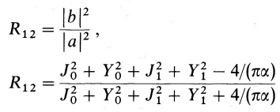
Hollweg’s 2-layer Model – Case I
Reflection coefficient calculated using Hankel functions:
Poynting Flux:
Photosphere
Hollweg’s work focussing on propagation of Alfvén waves in the solar atmosphere.
Thin flux tube approximation – first degenerate case.
$$v_{A}∝exp⁡(s/h)$$
Chromosphere
$$s<0$$
Transition region
$$v_{A}=v_{Ac}$$
Corona
$$s>0$$
Notes:
-To start this work off, I begun by studying some of Hollweg’s work which focusses on the propagation of Alfven waves in the solar atmosphere and a reflection coefficient is derived.
-He uses a simple thin flux tube approximation, which will form part of the first degenerate case.
-This model includes two layers, the first layer, where s is negative represents the chromosphere, and the second layer, where s is positive represents the corona.
-The transition region lies at s = 0.
-In the chromospheric layer, the Alfven speed is taken to be an exponential related to height, and above the transition region it is treated as constant.
-This reflection coefficient is calculated using Hankel functions, which are a combination of Bessel functions.
-These Hankel functions represent the outgoing waves and the ingoing waves.

Slide 14
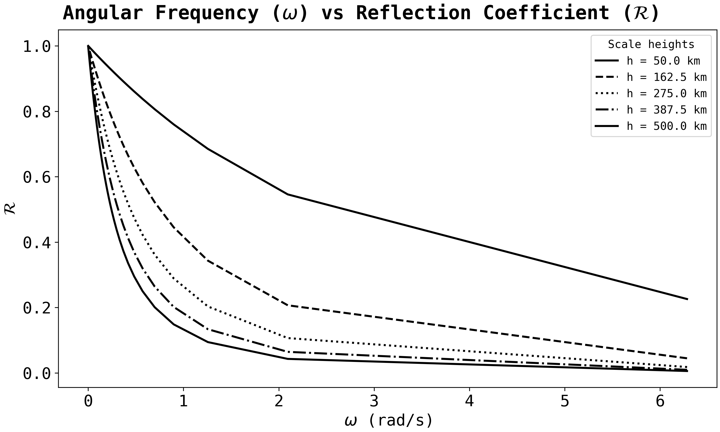
Reflection
Plotted reflection for various wave frequencies, and several scale heights.
Reflection much higher for low frequencies than high.
Notes:
-After spending some time working on rederiving some of the results, I begun visualising some of his results in Python.
-Using the equation detailed by Hollweg 1984 to plot his reflection coefficient, I plotted the coefficient for a range of different wave frequencies, and several different scale heights.
-As expected, for all scale heights, the reflection coefficient is much higher for lower frequencies, than for higher ones.
-The three stars are the points which I’ll be looking at in the next few slides
-Low, intermediate, and high freq.

Slide 15
Low Frequency Wave Parameters
$$x=v/r$$
$x →$ normalised wave vector
$v→$ wave velocity
$B→$ wave magnetic field
$F→$ wave energy flux
$s→$ height in atmosphere
Reflection coefficient ~ 1.00
Notes:
-Following on from this, I created some plots which show various wave parameters and their variation with height, for various wave frequencies and scale heights.
-This included the wave velocity (v), magnetic field (B), and the normalised component, x = v/r, where r is the flux tube width.
-For each of these values, I plotted the real and imaginary components.
-I also plotted the magnetic flux of the wave, which stays constant for each wave, as no energy should be escaping our system.
-This slide shows the results of a low frequency wave, which has a reflection coefficient of approximately one.

Slide 16
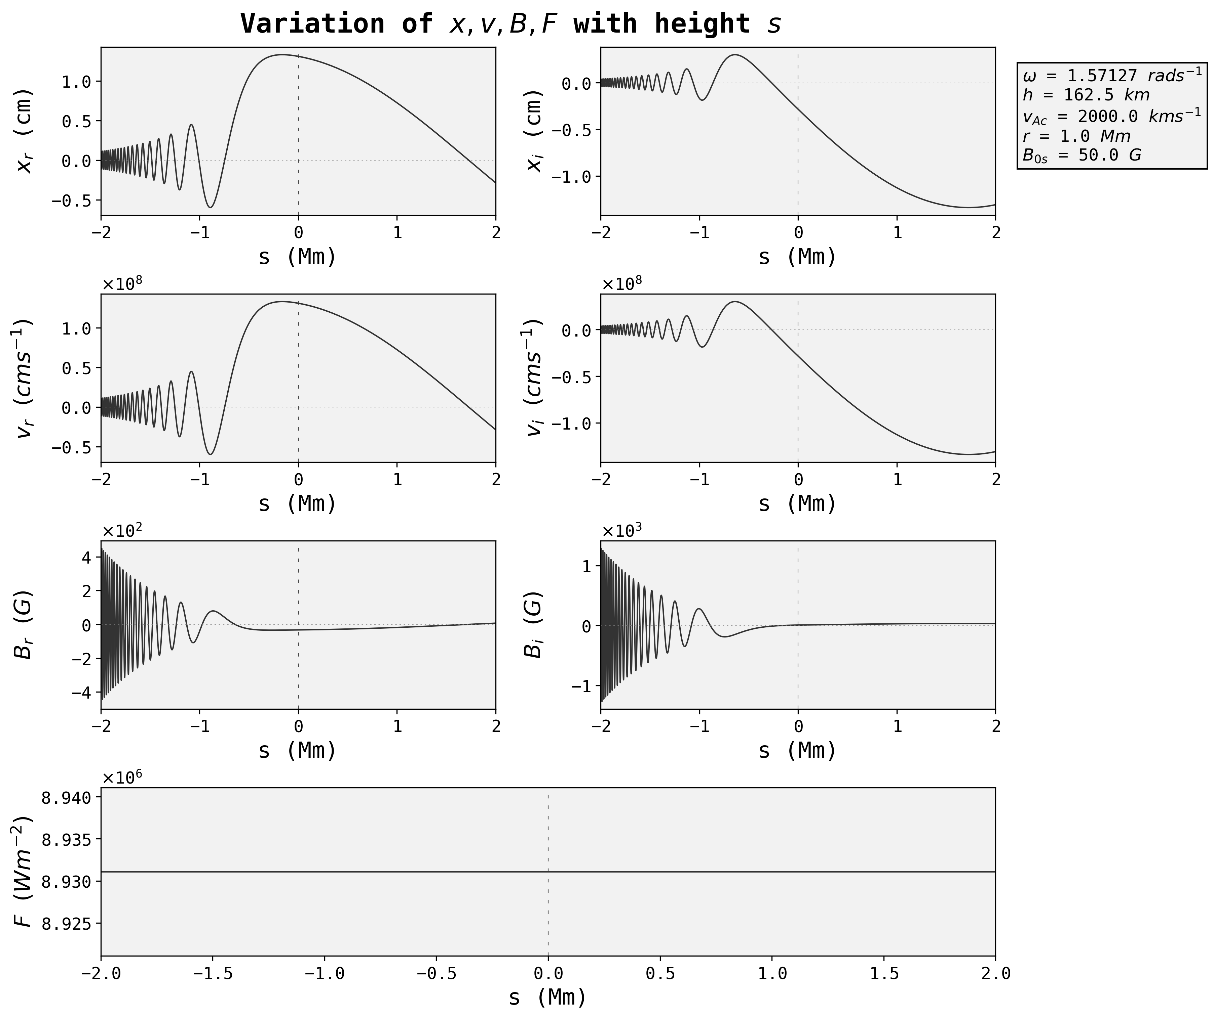
Intermediate Frequency Wave Parameters
$$x=v/r$$
$x →$ normalised wave vector
$v→$ wave velocity
$B→$ wave magnetic field
$F→$ wave energy flux
$s→$ height in atmosphere
Reflection coefficient ~ 0.15
Notes:
-Here we have the results for our highest frequency case, where the reflection coefficient is very low 0.15. This is a much lower reflection than the low frequency case, and as such we can see an big difference in the oscillations visible.

Slide 17
High Frequency Wave Parameters
$$x=v/r$$
$x →$ normalised wave vector
$v→$ wave velocity
$B→$ wave magnetic field
$F→$ wave energy flux
$s→$ height in atmosphere
Reflection coefficient ~ 0.05
Notes:
-Here we have the results for our highest frequency case, where the reflection coefficient is very low 0.05.
-This is very similar to our intermediate case as they have very similar reflection coefficients.

Slide 18
Poynting Flux
Energy carried by the wave at the transition region for various angular frequencies and several scale heights.
Similar graph to reflection coefficients.
Notes:
-I also plotted the Poynting flux for several scale heights for varying angular frequency, which is visually almost identical to the variation in reflection coefficient.

Slide 19
Current/Future
Working on visualising results of three cases.
These will be presented as a poster at NAM 2023.
Working on getting this paper submitted – end of summer.
Work on next case will begin in autumn – potential field, submission in spring.
Notes:
-Working on visualising results of three cases.
-These will be presented as a poster at NAM 2023.
-Working on getting this paper submitted – end of summer.
-Work on next case will begin in autumn – potential field, submission in spring.

Slide 20
Summary:
Alfvén waves can play an important role in heating the solar atmosphere and solar wind acceleration.
Previous studies have demonstrated strong reflection of waves at the transition region.
Recent observations have revealed strong upward flux of Alfvén waves.
Previous studies have used models that represent degenerate cases in the Klein-Gordon equation.
References:
Hollweg (1984)
Jess et al. (2009)
MHD waves in the solar atmosphere (Roberts)
Wedemeyer-Böhm et al. (2008)
Tahlina Borradaile
tab22@aber.ac.uk
Room 3.13
users.aber.ac.uk/tab22
Notes:
-Alfvén waves can play an important role in heating the solar atmosphere and solar wind acceleration.
-Previous studies have demonstrated strong reflection of waves at the transition region.
-Recent observations have revealed strong upward flux of Alfvén waves.
-Previous studies have used models that represent degenerate cases in the Klein-Gordon equation.

Slide 21
The cut-off frequencies
$$Ω_{1}^{2}=\frac{c_{A}^{2}}{A}\frac{∂^{2}A}{∂s^{2}}, Ω_{2}^{2}=Ac_{A}\frac{∂^{2}}{∂s^{2}}\left(\frac{c_{A}}{A}\right),$$
$A^{2}={B_{s}r}^{2}=$ const for (a) thin flux tubes,
(b) uniform magnetic field,
(c) radial magnetic field
$Ω_{1}=0$ and $Ω_{2}=0$represent degenerate cases of the Klein-Gordon equation with 0 cut-off frequencies.

Slide 22
Degenerate cases correspond to 100% reflection at low frequencies
$$Case II$$
$$Case I$$
Corona
Interface
$$s=0$$
(Transition region)
$$r$$
Chromosphere

