Slide 1
Lessons from engineering: Can software benefit from product based evidence of reliability?
Neal Snooke
Department of Computer Science
Aberystwyth University

Slide 2
Outline
Some observations about software
How might we better analyse non functional software characteristics?
Failure Modes and Effects Analysis as an example
how it might be applied to software.
Conclusion

Slide 3
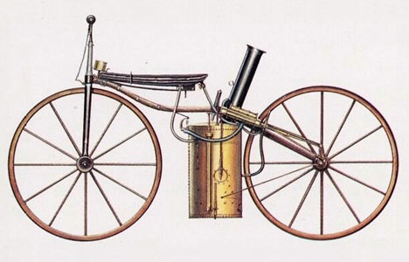
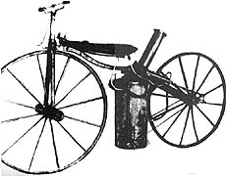
Engineering - an Endless Frontier Sunny Y Auyang Harvard University Press,
2004
"The forerunners of engineers, practical artists and craftsmen, proceeded mainly by trial and error. Yet tinkering combined with imagination produced many marvelous devices. Many ancient monuments cannot fail to incite admiration. The admiration is embodied in the name “engineer” itself. It originated in the eleventh century from the Latin ingeniator, meaning the ingenious one. Leonardo da Vinci bore the official title of Ingegnere Generale. His notebooks reveal that some Renaissance engineers began to ask systematically what works and why."
Notes:
A steam-powered bicycle was actually built in the United States. It was the first thing that could be called a motorcycle

Slide 4
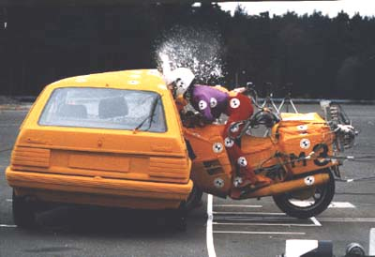
Engineering Software
We know how to create software and sometimes it works quite well; sometimes not.
However it is not enough that an Engineered product merely works:
reliable; safe; robust; maintainable; diagnosable; failure characterised; prognosable; inexpensive
Engineers analyse systems and measure these characteristics
Notes:
Then verify all the analysis is correct by testing.

Slide 5
Software quality evidence
Development processes and practices
Important (in any form of engineering)
Do not guarantee quality or safety
Testing
Can initially indicate quality
Repeated and hierarchical testing does not
Testing is a high precision, but low coverage method
Notes:
Software engineering focuses on lifecycles, management methodologies, testing, testing, testing…
Some development processes use test-first development. This does limit unnecessary functionality but makes the tests even less able to indicate quality.

Slide 6
Software is very complex
There are no physical constraints such as spatial partitioning, mass, material strength to limit the size or complexity of software
So we must create paradigms and enforce them
Current paradigms are such that the non functional analysis is difficult to determine
Even than complex physical systems and those can have complex fault interactions
We will concentrate on one type of analysis: Failure Mode and Effects Analysis
Notes:
Non functional analysis such as reliability, failure effects, diagnosability, resilience, safety etc

Slide 7
FMEA
FMEA is a systematic safety analysis method that identifies possible system failure modes.
It doesn’t prevent the system failing, but it does mean we understand how it can fail and ensure really bad stuff doesn’t happen.
FMEA provides a “what if” analysis for a wide range of hypothetical faults
Provides understanding of failure mechanisms
Locates unexpectedly serious faults
Aims to ensure uniform quality

Slide 8
Software doesn’t wear out
It is pure logic…
and therefore could be perfect
Other engineers must anticipate failure at design time
Because physical devices deteriorate over time and must survive their environment
This leads to a greater design awareness and range of development / analysis tools
Complex software does provide symptoms of wear out…
Notes:
Software stops working for many reasons:
Environment changes,
subtle user changes,
Bugs that are revealed by an apparently unrelated change to usage

Slide 9
FMEA: Analysis tractability
High coverage, reduced precision, worst case analysis
Note low precision does not mean inaccurate
For example a low precision input could be {good, faulty}.
An accurate analysis will correctly categorize outputs as {good, faulty, possibly faulty}.
Notes:
Software is highly nonlinear compared to most physical systems

Slide 10
Need a suitable computational infrastructure
Localising and limiting effects of faults
Data typing
Structured code
Proceedural
OO
Aspect oriented
MDA
Still need better constraints on dynamic structures
Increasing constraint

Slide 11
Faults
Software processes inputs to produce outputs.
although these elements may be abstract
Low level faults result from:
faulty input/output (wrong value)
faulty/unexpected transfer functions (algorithm/ implementation.)
loss of transfer function (non execution)
missing input/output
unexpected input/output
These basic issues are manifest as more specific issues. E.g. exception raised, functional failure, logic error, initialized variable, …

Slide 12
An experiment
Use a behaviour model based on source code (imperative languages):
Use single assignment form (SAF) to track faults through stack variables
Build a fault dependency graph based on statements (nodes) and variables (edges)
Use a qualitative fault propagation to propagate through statements
Abstract heap structures using shape analysis
Interpret abstract behaviour using a functional model
Note no code execution

Slide 13
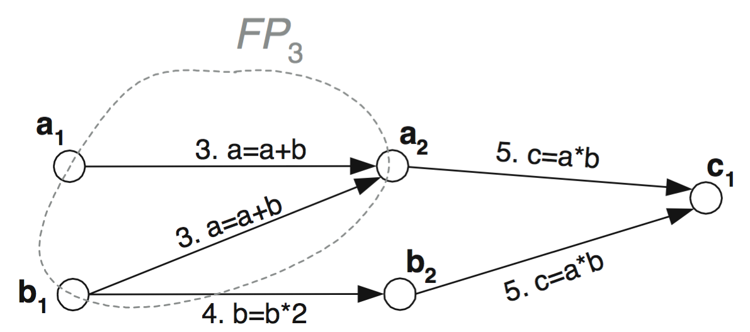
SAF Fault Propagation Model
source SAF FP arcs
1 a=1; a₁=1; (∅, a₁)
2 b=2; b₁=2; (∅, a₂)
3 a=a+b; a₂=a₁+b₁; (a₁,a₂),(b₁,a₂)
4 b=b*b; b₂=b₁*2; (b₁,b₂)
5 c=a*b; c₁=a₂*b₂; (a₂,c₁),(b₂,c₁)
Notes:
SAF Variables are nodes, statements are edges

Slide 14
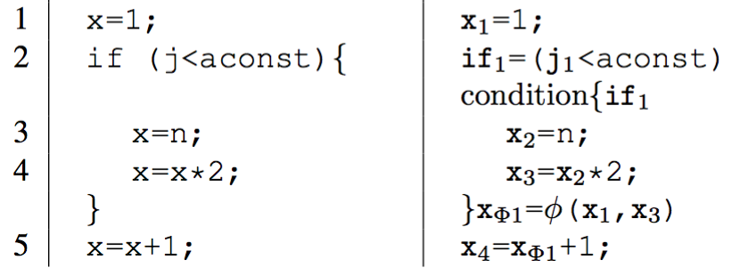
Conditions - example
Notes:
Oracle function (Collard) aggregates reaching definitions
ie e={12345} and e={125}
For some execution we assume each propagation path will be used
IF not (eg. Some path is not allowed because of application constraint, and it leads to important failure mode then we should document it ! And explicitly add constraint (then it can be auto checked)

Slide 15
Data structures
For some applications we can avoid complex datastructures:
Eg. Embedded systems (e.g. MISRA C)
Some scripting languages
Aliasing
Module side effects
Abstract shape graphs
Notes:
Shape graph effectively represents a FSM that can generate any dynamic structure possible in the code.
Perhaps for complex structures we should explicitly define this to assist with analysis.

Slide 16
Abstract shape graphs
Notes:
Shape graph effectively represents a FSM that can generate any dynamic structure possible in the code.
Perhaps for complex structures we should explicitly define this to assist with analysis.

Slide 17
S U M M A R Y
Blocks | Faults | Failure Mode
#S1'class Expenses{}' , #S4'Expenses(...){...}' , #S19'calculateMileage(...){...}' , #S30'findExpenseTotal(...){...}' , #S39'printCheque(...){...}' , #S53'display(...){...}' ] | #V1'RATEA' , #V2'RATEB' , #V3'expense_cost' , #V4'milage_cost' , #V5'employee_no' , #V32'ar' ,, #V59'comment' , #V74'prompt' , #V77'OUTPUT1’
#S4'Expenses(...){...}' , #S30'findExpenseTotal(...){...}’ | #V6'hotel' , #V7'sundries' , #V43'hotel' , #V44'sundries’ | VALUE [Display expenses total, Print cheque]
#S4'Expenses(...){...}’ | #V10'emp' , #V16'employee_no’ | VALUE [Print cheque, Envelope]
#S4'Expenses(...){...}' , #S39'printCheque(...){...}' , #S50'produceEnvelope(...){...}’ | #V9'address' , #V64'employee_no' , #V70'adress' , #V72'OUTPUT_ENVELOPE' , #V73'employee_no’ | VALUE [Envelope]
#S4'Expenses(...){...}' , #S19'calculateMileage(...){...}' , #S30'findExpenseTotal(...){...}' , #S39'printCheque(...){...}' #S56'formatText(...){...}’ | #V8'milage' , #V12'RATEA' , #V14'RATEB' , #V20'milage_cost' , #V24'expense_cost' , #V30'miles' , #V33'br' , #V35'RATEB' , #V36'br' , #V37'miles' , #V38'br' , #V39'miles' , #V40'RATEA' , #V41'ar' , #V57'emp_no' #V60'total_cost' , #V61'expense_cost' , #V62'milage_cost' , #V63'PRINTER_P' , #V66'PRINTER_T' , #V67'PRINTER_S' , #V79'number’ | VALUE [Print cheque]
#S53'display(...){...}’ | #V75'answer' , #V78'OUTPUT2’ | [Display expenses total]

Slide 18
Conclusion
We need tools to provide wider ranging analysis of software to provide product based evidence of quality.
Software is becoming ever larger more abstract and pervasive providing both advantages for analysis and the potential for very subtle faults and oversights.
Analysis should be built into the design of new software `infrastructures’ (languages, modelling, transformation tools and the like).
There are a number of non software engineering reliability techniques that can be adapted for software use.

Slide 19
Kinds of reliability analysis
Verify that the design supports reliable provision of the required functions
Architectural, inherent reliability
Validate that the implementation conforms to the design
Is the failure analysis consistent with the expectation of the high level design?

Slide 20
Weak or strong ?

Slide 21
Use qualitative faults
Abstract model of code and data structures but generated accurately from code itself (or executable model)
Functional interpretation of results to allow worst potential faults to be categorised and explained.

