Slide 2
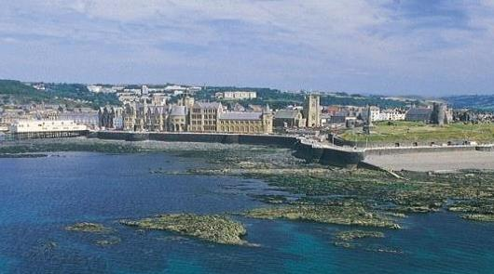
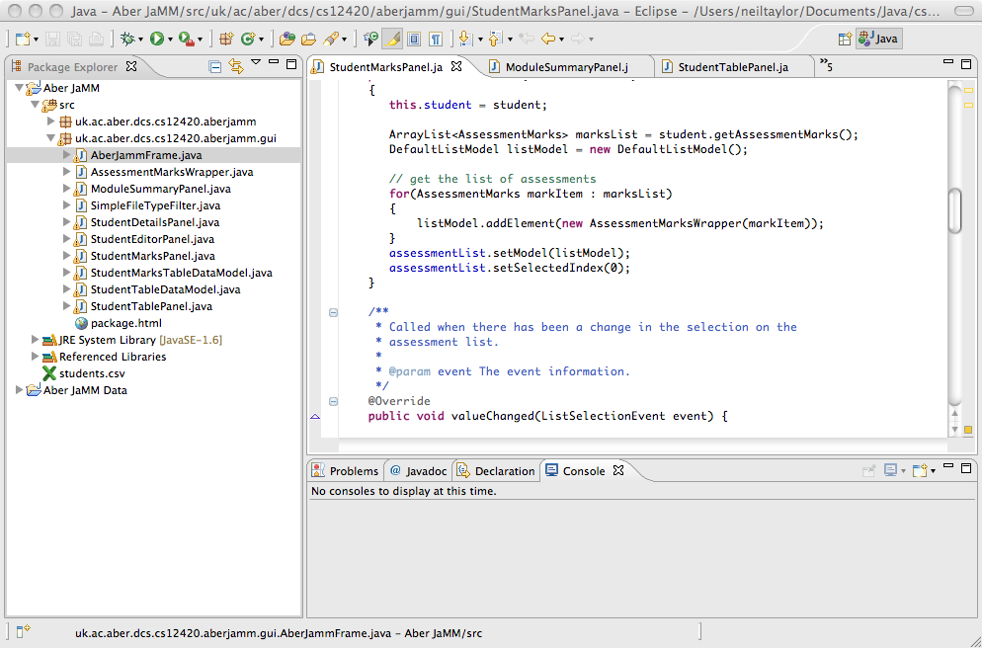
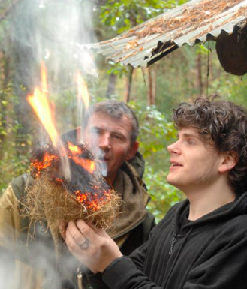
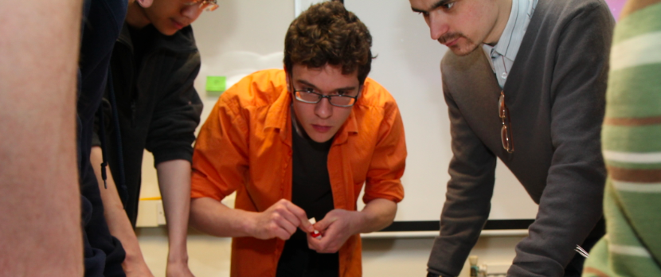
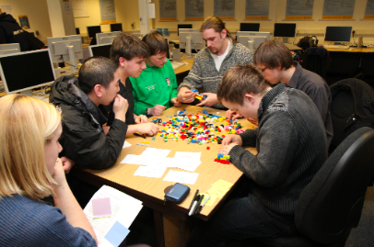
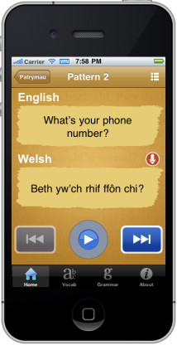
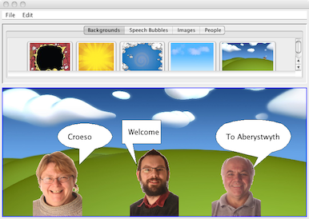
Computer Science
Lynda Thomas – SeNIOR LECTURER, ACADEMIC ADVISOR

Slide 3
Plan for the day
Talks:
  What you study
  Student life
  Team building and careers
Tea and Cake
Tour
Parents Q & A
Parents Tour &
Accommodation
talk
Show&Tell / Chat
Home

Slide 4
Plan for the day
Talks:
      What you study (Lynda)
      Student life (Connor)
      Team building and careers (Neil)
Tour
Show&Tell /
Chat
Parents’ Q & A
Bus to accommodation
3:30 Tea and Cake
Show&Tell / Chat
Tour
Parents’ Walking Tour
4:20 Accommodation talk – A12
5:00 Home

Slide 5
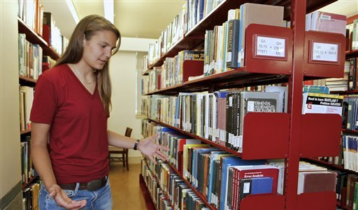
Checking out your Uni choices

Slide 6
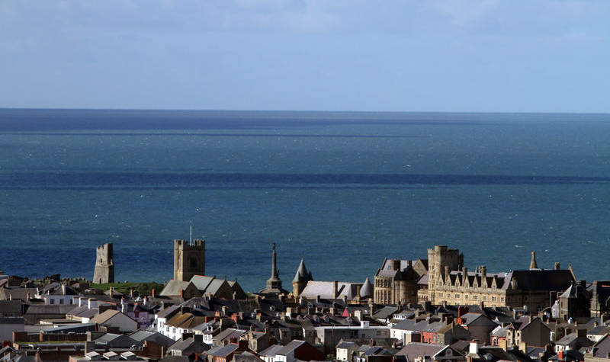
.. the town & atmosphere
Notes:
Here is a view of the town of Aberystwyth from the sea,
with the original university building of 1872 in the front,
and the more recent campus at the back.

Slide 7
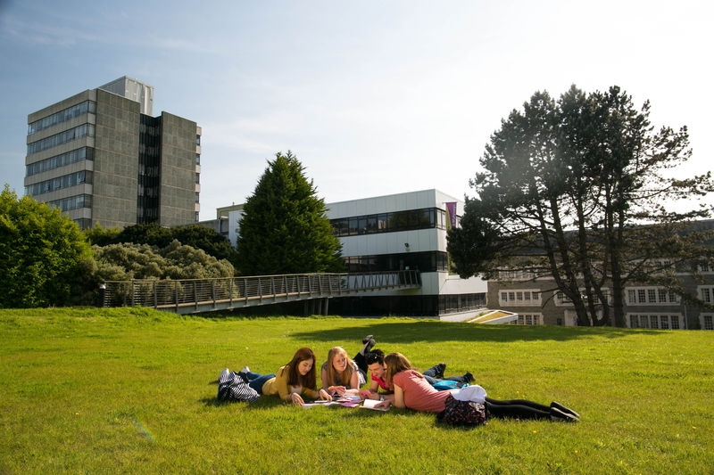
.. the learning environment

Slide 8
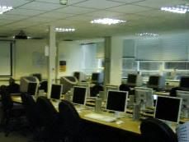
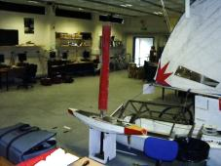
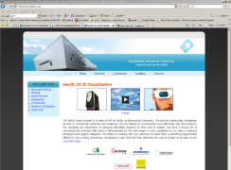
.. the equipment
Computers
  2 workstation rooms JUST for CS students, one for linux, one for Macs
  DSL - Small computer systems and networking equipment
Robotics laboratories
  Assembly robots
  Mobile robots
  Aerobots
  VICON vision system
Notes:
We have been generously supported by Sun Computers,
who have provided roughly a million pounds of free equipment over the past three years.
We have also acquired further equipment through government research grants,
and are well supported for our research needs.
The Robot Scientist work is at the stage where more facilities are needed, and the
University is currently furnishing a new laboratory for this work.
The University has recently launched the building of a new £11M Visualization centre,
that will have a hemispherium and other advanced equipment. Our VICON will be rehoused
there, and we see this building as very important for our growing visualization work.

Slide 9
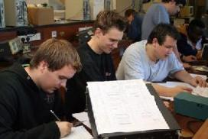

.. the course
What will I study?
What will I do then?
Help you make a decision about Aber and
(to some extent) us make a decision about you

Slide 10
What does a CS department do??
Consulting with external companies
Research
  Latest Research Excellence Framework:
    11th in UK and best in Wales in terms of ‘intensity’!
    This means you are actually taught by the people who were part of this review.
  Source of final year projects and even jobs
Teaching – the most important to you!

Slide 11

Aim of our courses
We seek to produce graduates who have:
  a broad knowledge of Computing,
  good intellectual skills, and
  strengthened interpersonal skills.
So that they…can adapt and be relevant in 10 years time.
Do we succeed?
  Degrees accredited by BCS – Chartered Institute for IT - on behalf of the Engineering Council
  Our students get good jobs in the Computing industry
  (95% are in work or further study 6 months after graduation and 92% are in graduate level employment or study) ….
  ….we also have fun
Notes:
This slide contains our stated aims for our undergraduate courses.
As I said, we have an emphasis on software engineering,
and on producing graduates that will be employable immediately,
but adaptable as the computing industry continues to undergo rapid change.

Slide 12
Undergraduate Courses
Common themes to degrees
  Common first year of study, and much of second year
  Emphasis on adaptable, vocationally oriented computing education
Degree schemes offered:
  Computer Science
  Software Engineering
  Internet Computing and Systems Administration
  Business Information Technology
Degree ‘flavours’ linked to our research interests
  Computer Science with Artificial Intelligence
  AI and Robotics
  Computer Graphics, Vision and Games
Notes:
We have undergraduate degrees with a range of titles.
However, they all have some emphasis on our main strengths - software engineering and artificial intelligence.
Many of our staff have previously worked in industry,
and so we emphasize the skills that are needed to be able to engineer software rather than just program.
That is why all of our degrees contain at least the option of the student spending a year working in
the computer industry during their degree, so that they gain experience of real software projects.
We have an Advanced MSc in Distributed and Internet Systems.
This takes students who already have Computing degrees and gives them deeper study in the areas of
networked systems and enterprise web systems.
We have recently decided that we should have more taught MScs in our main research areas,
and are intending to start new MSc courses in AI and in Vision and Visualization.

Slide 13
Features of all our degrees
Flexible
  You can change scheme or mix and match
Vocational
  Activity weekend in first year - team skills
  Professional skills weekend in second year
  Encouraged to spend a year in industry
  Project based
Hard Work – Lots of project work!

Slide 14
Common First Year but YOU are all different…

Slide 15

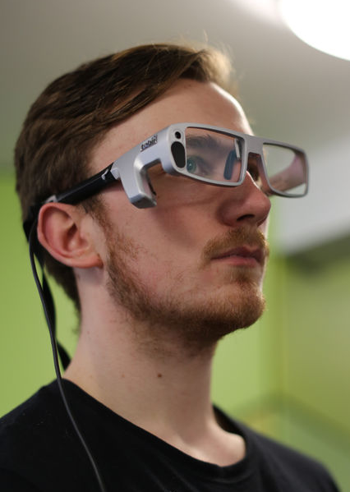
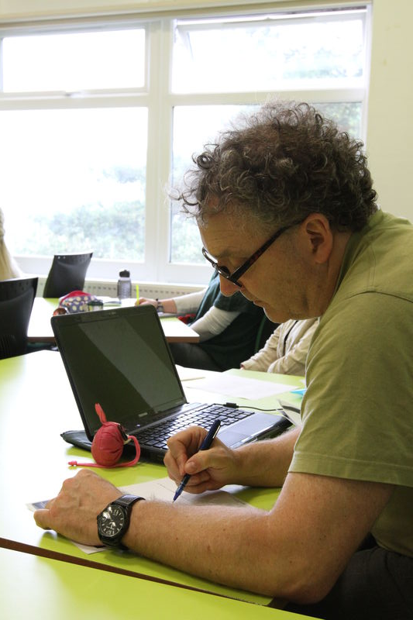
Bill – G400
No Maths A Level
GCSE maths ‘A’
No programming
Intro to Programming
(C and Arduino)
Mary – G451
Maths A Level
Lots of programming experience
Web Tools
(xml, html, Javascript)
Intro hardware & Operating Systems
Maths driving license
Chaos & Comms
Haskell
End of semester 1
Telecomms
Intro to Object-oriented programming
Professional Develop.
Paul – G500
Mature student with old qualification in Art & Business
Introduction to Business
Problems and Solutions in Computing
End of semester 2

Slide 16
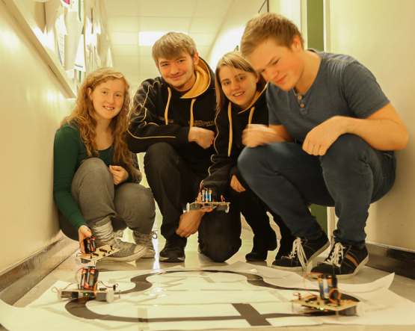
Different schemes and experience

Slide 17
Moving into the Second Year
You may arrive on one degree scheme and wish to change to another.
That is fine if you have the prerequisites
Many students change scheme more than once.

Slide 18
Some of the Modules - Year 2
  Data Structures & Algorithms
  Architecture & Hardware
  C and Unix
  C++
  Database and Modelling
  Artificial Intelligence (x2)
  Introduction to Robotics
  Systems Admin.
  Web Programming
  Image Processing
  Interactive Graphics for web
  Mobile Computing
  User Centred Design
  Commercial Databases
  …………….and more
Focus: Software Development Lifecycle

Slide 19
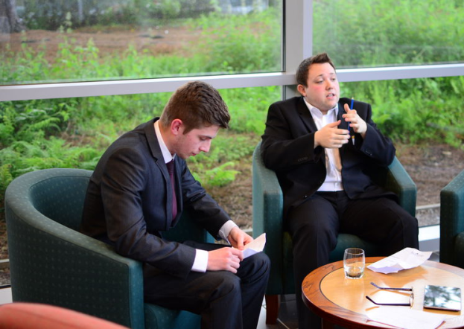
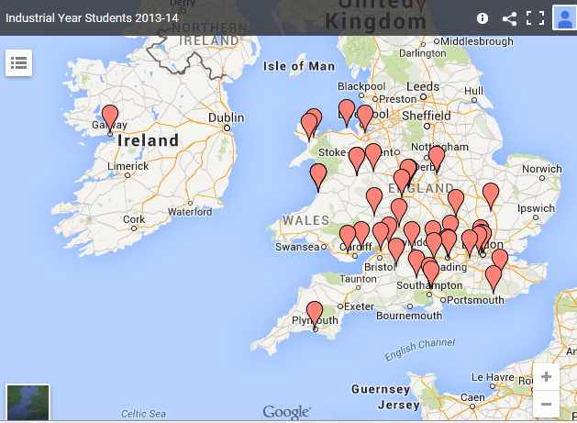
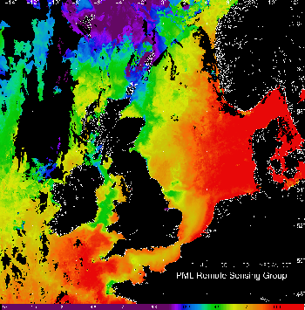
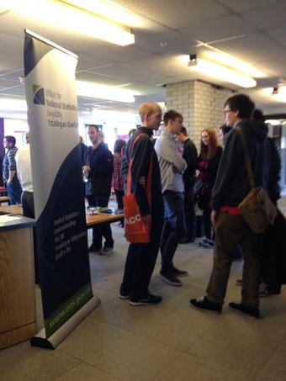
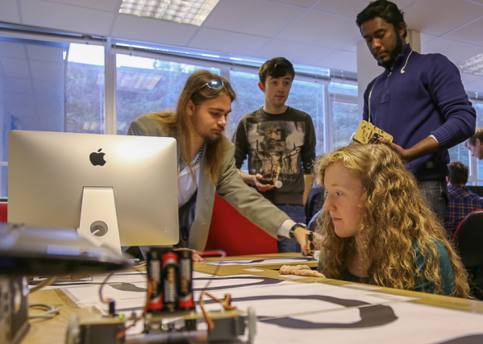
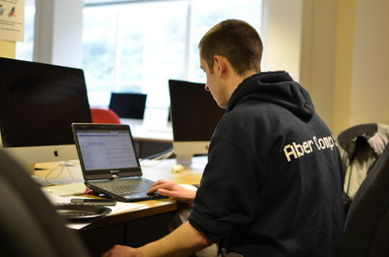
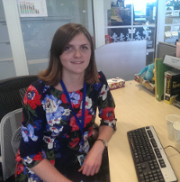
Between years 2 and 3
Year in Industry (optional)

Slide 20
Some of the Modules - Year ‘3’
  Distributed Systems
  Agile Methodologies
  Professional Issues
  E-commerce
  Network Technologies
  Internet Admin.
  Intelligent Robotics
  Ubiquitous Computing
  Open Source Development
  Artificial Intelligence Concepts
  Space Robotics
  Advanced Computer Graphics
  Computer Vision
  Visualisation
  …………….and more
  Focus: Individual Project (33% of time)

Slide 21
Modules (with MSc)
Year ‘4’ (MEng)
  Developing applications for mobile platforms
  Hot Topics in Software Engineering
  The Internet And How It ‘Really’ Works
  Introduction to Intelligent Systems
  Developing Advanced Internet-Based Applications
  Distributed Group project

Slide 22
Support and tutoring
All of the following are available for help and advice:
Personal tutor – member of staff
Tutors for small groups in years 1 and 2
cs-feedback and staff-student consultative committee
Academic Advisor
Year tutor – in charge of whole year
Lecturers – happy to answer questions
Demonstrators – in the labs (more advanced students)
Industrial Year supervisor – visits you on site
Final year project supervisor – weekly meetings
Careers office
Student Support

Slide 23
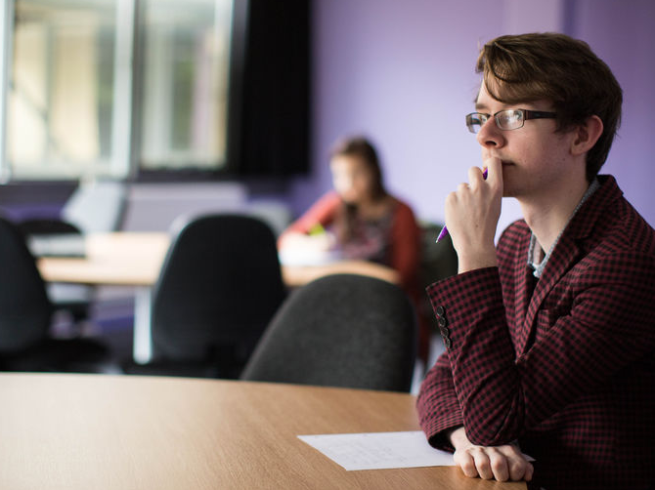
To help you decide:
Ask anyone today, or email
cs-admissions@aber.ac.uk
courses.aber.ac.uk & www.aber.ac.uk/modules

