Slide 1
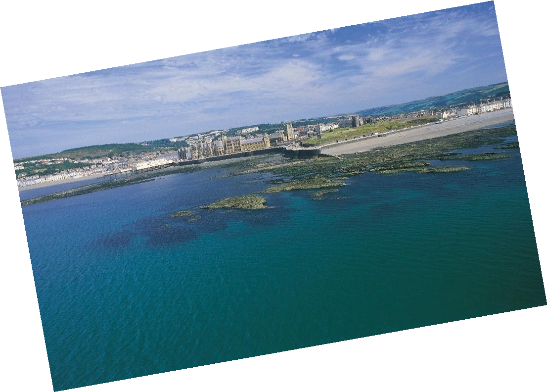
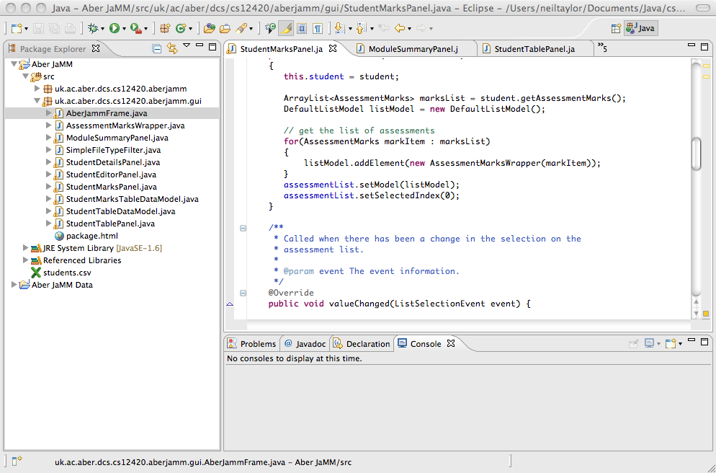
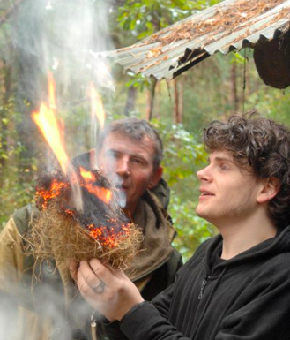
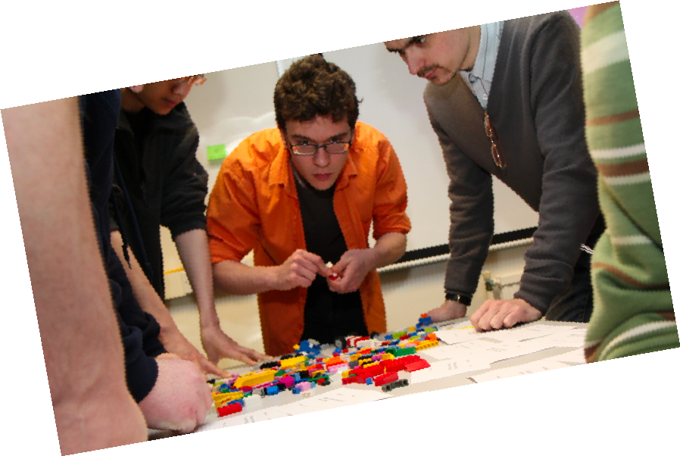
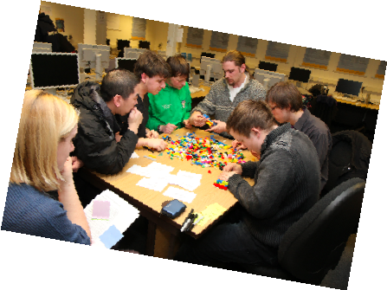
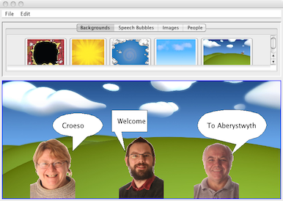
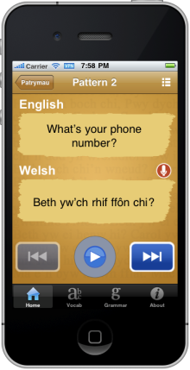
Computing at Aberystwyth
What we teach and how it is organised

Slide 2
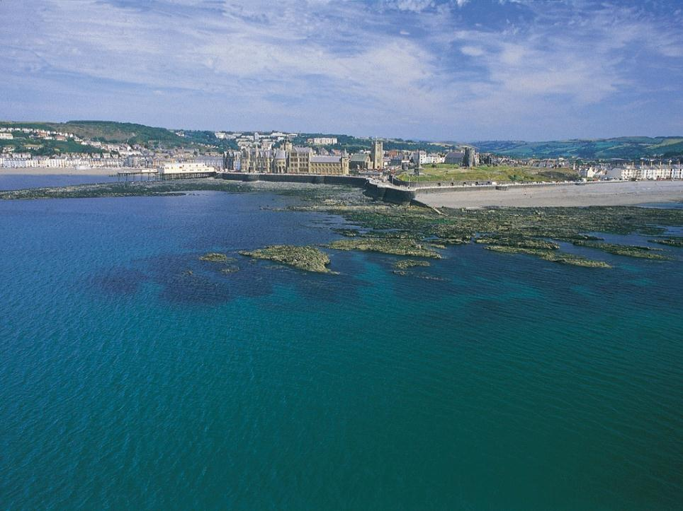
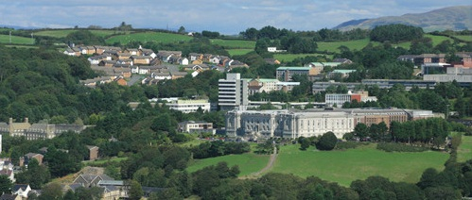
Notes:
2
Here is a view of the town of Aberystwyth from the sea,
with the original university building of 1872 in the front,
and the more recent campus at the back.

Slide 3
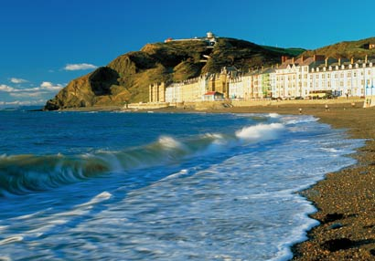
Objectives of this Talk
Tell you about our degrees
Show you what some graduates have done

Slide 4
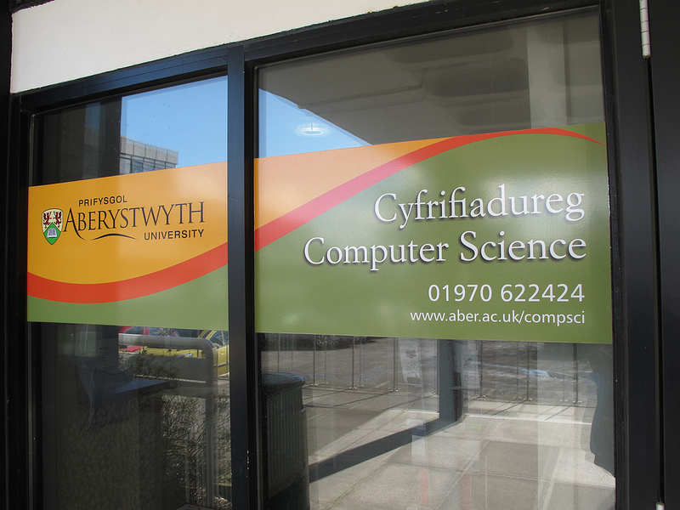
Structure of Department
On main (Penglais) campus
30 full-time lecturing staff plus some part time staff helping out
600 undergraduates and MSc students
20 support and research staff
38 PhD students
Notes:
4
We are a medium-sized computing department in UK terms.
Size of first year: approx 240
Depends on the course/degree scheme as to what class sizes will be like

Slide 5
Aim of our courses
We seek to produce graduates who have:
  a broad knowledge of Computing,
  a wide skills base,
  good intellectual skills, and
  strengthened interpersonal skills.
So that they ….
can adapt and be relevant in 10 years time.
Ideas
Training
Notes:
5
This slide contains our stated aims for our undergraduate courses.
As I said, we have an emphasis on software engineering,
and on producing graduates that will be employable immediately,
but adaptable as the computing industry continues to undergo rapid change.
A balance between ideas (theory) and training (practice)
We try to impart a broad knowledge that will last. Some principles are long-lasting in CS, others change over time.

Slide 6
Do we succeed?
Our students get good jobs in the computing industry: June 2015: Higher Education Statistics Agency DLHE Survey for 2013-14:
  95% in full-time employment/further study
  92% in graduate employment/further study
Degrees accredited by BCS (The Chartered Institute for IT)
Top marks in last QAA assessment
11th in UK for “Research Intensity” in 2014 REF
(Research Excellence Framework)
Notes:
Not many places get high marks for both teaching and research
DLHE (Destination of Leavers from Higher Education) survey: asks leavers from HE what they are doing 6 months after graduation. Highest in Aber for graduate employment.
REF: Research intensity: average quality of publications * percentage of eligible staff who submit
6

Slide 7
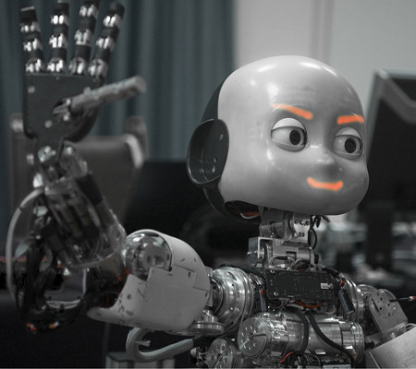
Undergraduate Courses
Degree schemes offered:
  Computer Science
  Software Engineering
  Internet Computing and Systems Administration
  Business Information Technology
Degree ‘flavours’ linked to our research interests
  Computer Science with Artificial Intelligence
  AI and Robotics
  Computer Graphics, Vision and Games
Notes:
7
We have undergraduate degrees with a range of titles.
However, they all have some emphasis on our main strengths - software engineering and artificial intelligence.
Many of our staff have previously worked in industry, and so we emphasize the skills that are needed to be able to engineer software rather than just program.
That is why all of our degrees contain at least the option of the student spending a year working in the computer industry during their degree, so that they gain experience of real software projects.
Perhaps warn about CGVG degree scheme – it’s not about playing games, level design, etc!
Also MScs in related areas

Slide 8
THE COMMON THREADS

Slide 9
Features of all our degrees
Year 1
Mostly in common
V
O
C
A
T
I
O
N
A
L
Year 2
Group project
Year in industry
(optional)
Year 3
Final Year Project
Notes:
Year in industry is mandatory for Engineering schemes

Slide 10
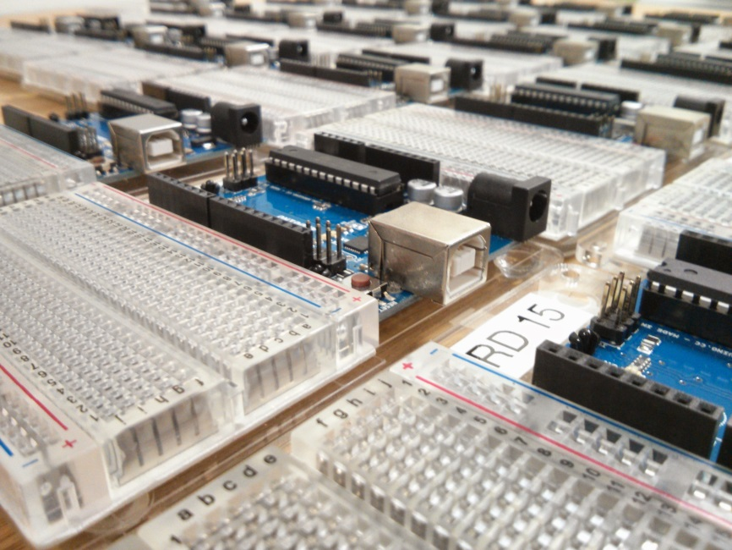
Common Core
Flexible – you can change scheme or
mix and match
Different backgrounds brought to same
level
Notes:
We try to get everyone up to the same or similar level for the second year, so this depends on the individual as to which modules they will need to take.
E.g. Maths module if you’ve got A-level Math, a module on Computational Thinking if you haven’t done programming before
10

Slide 11
Year 1- Mostly Common
Introduction to Programming
Web Development Tools
Introduction to Computer Hardware, Operating
Systems and Unix Tools
Professional and Personal Development
An Option: Review Mathematics, Computational Thinking, Functional Programming, others
Problems and Solutions
Programming Using an Object-Oriented Language
An Introduction to Communications and Telematics
Professional and Personal Development
Notes:
We try to get everyone up to the same or similar level for the second year, so this depends on the individual as to which modules they will need to take.
E.g. Maths module if you’ve got A-level Math, a module on Computational Thinking if you haven’t done programming before
11

Slide 12
Year 1- Business IT
Introduction to Programming
Web Development Tools
Introduction to Computer Hardware, Operating Systems and Unix Tools
Professional and Personal Development
Business Environment
Financial management
Programming Using an Object-Oriented Language
An Introduction to Communications and Telematics
Professional and Personal Development
Business Environment
Notes:
Big difference here is no Problems and Solutions module and a focus on some foundational Business modules.
12

Slide 13
Year 2 - The Group Project
Year 2
Team of about 10
Whole product development process
Notes:
Different people are responsible for different tasks, e.g.:
Group leader
QA
2 or 3 programmers
Someone responsible for documentation
Obviously smaller-scale than industry but gives experience as to what it’s like in group situations.
13

Slide 14
The Group Project
Android and server-side walking application
  Use GPS to gather points along a walk
  Add points of interest (photos, info about sites)
  Show data on a web application
The bigger aim is to work as a group.

Slide 15
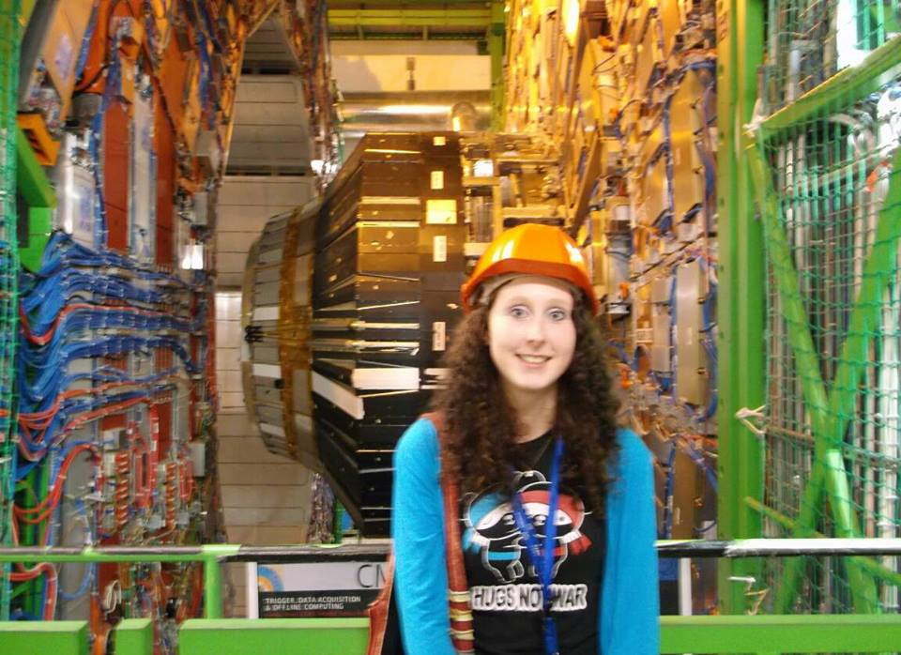
Optional Year in Industry
between years 2 and 3
Notes:
Our IY co-ordinator says that he hasn’t been able to place anyone that he thought deserved a place (i.e. put the effort in!), so if you’re a good student then you should probably get a paid placement.
Our students are worth their money, most companies know that (there are plenty of paid jobs out there)
Average pay around £16k, placements all over the place (link in future slide)
15

Slide 16
Year 3 - Final Year Project
Significant proportion of your time
Individual working
Complete project
May be research led by staff member …
…or from your industrial year
Specify, develop, test, deliver a product
Personal challenge
Notes:
You do everything, from beginning to end, but with supervision. It can be self-proposed.
16

Slide 17
THE DEGREES

Slide 18
BSc in Computer Science
G400 - 3 years, G401 - 4 years
Most flexible
Covers core modules:
  Programming, hardware, software engineering,
  professional issues, telecommunications,
  database management systems, data structures & algorithms,
  human computer interaction, and electives
Types of final year project:
  Plant growth monitoring in Arabidopsis,
  Rover walking: switching between rolling and walking locomotion,
  iCub musician,
  Interactive fiction around Aberystwyth

Slide 19
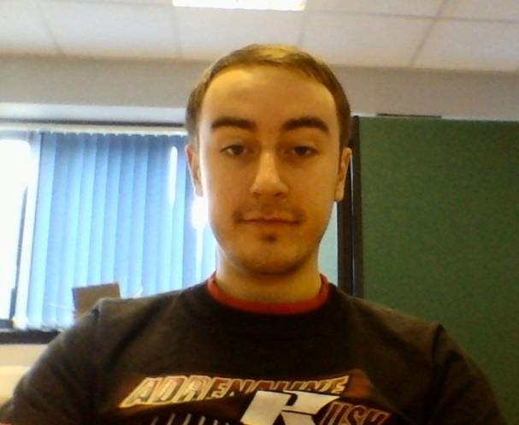
Andrey Ustalakov
Computer Science G401
Industrial year at Grid Tools near Oxford
Final project: Modelling plant and
insect populations over time
Went to work at Grid Tools
(software for test data management)
Also studying part time MSc in
Software Engineering at Oxford Uni

Slide 20
BEng in Software Engineering
G600 - 4 years
Emphasises professional engineering of large,
high-quality software systems
More technical – almost all modules must be in CS
Compulsory industrial year
Covers:
  Core modules plus: C and Unix, C++,
  distributed systems technologies and other electives
Types of final year project:
  Student budgeting app,
  The Script Tutor,
  Clinical decision support applications

Slide 21
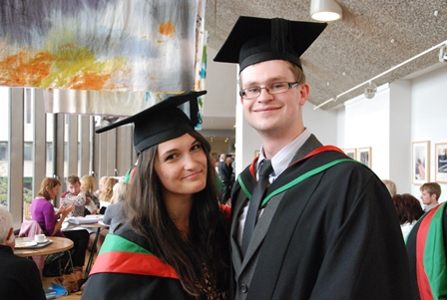
Silvia Teodorescu and Ed Parry
BEng Software Engineering and
BSc Computer Science
Final Projects: Classifying crime stories in
NLW digitised newspapers, iOS Tourism catalogue
Ed works for Method4 in Cardiff,
Silvia for Sorenson Media

Slide 22
MEng Integrated Masters
MEng G601 – 5 years
  Our most prestigious scheme (higher entry requirements: 340 points)
  Final year all modules with MSc students
  Extra modules taken with MSc students
  such as Programming Mobile Solutions, Autonomous Systems, …
Notes:
Entry requirements are higher for this scheme as this requires very good students. (340 points with B in any A level﻿)
22

Slide 23
BSc in Internet Computing and Systems Administration H602 - 3 years, H603 - 4 years
Building professional quality web sites, applications and
setting up and administering networks
Covers:
  Core modules plus: Web programming, website design,
  database driven web sites, business processes,
  E-commerce systems and internet security, systems admin…
Types of final year project:
  University student accommodation website,
  Rambling walker – web based application

Slide 24
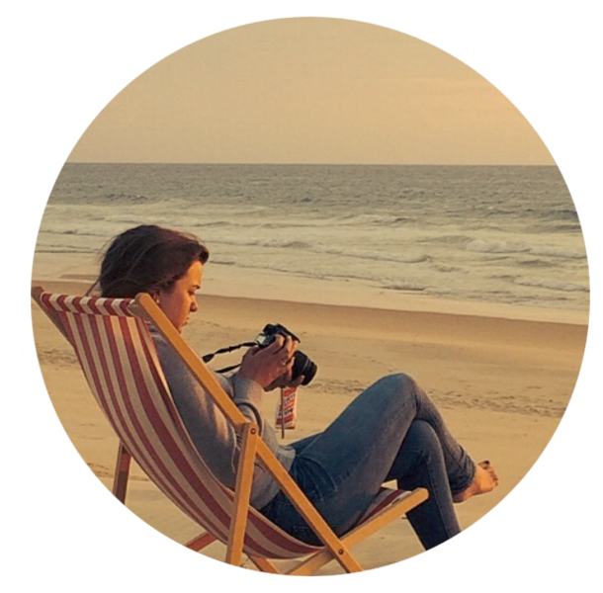
Kathryn Rogers
Internet Computing and
Systems Administration
Final Year Project:
Handmade craft business
http://www.kathrogers.co.uk/
Also working for Pembrokeshire College as a developer

Slide 25
BSc in Business Information Technology
G500 - 3 years, G501 - 4 years
Concerns methods and technologies that can be used to
create effective IT systems as solutions to business problems
Covers:
  Web programming, systems analysis, DBMS and
  commercial applications, professional issues, business process
  engineering, E-commerce systems and internet security,
  web development tools.
  Some modules are taken in other departments such as
  Management and Business
Types of final year project:
  River level info for canoists,
  South Wales cottage website, student laundry service
Notes:
Rather than emphasising programming, this concentrates on analysing business requirements and translating them into systems
25

Slide 26
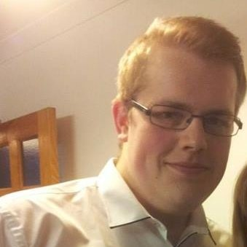
Luke Ryan
Business Information Technology
Industrial Year in Information Services,
followed by working for I.S. part time in his final year
Set up Instant Chat system
Final year project: Charity website
Now: BlueBay Asset Management (IT infrastructure analyst)
“From now on whenever someone asks what I do
I'm not going to tell them I work in IT,
plumber of the 21st century is a better description”

Slide 27
BSc degrees with Artificial Intelligence
CS & AI: GG4R - 3 years, GG47 – 4 years
AI & Robotics: GH76 - 3 years, GH7P – 4 years
Explores artificial/computational systems that can do
things that are normally regarded as requiring intelligence
Covers:
  Core modules plus: Practical application of AI, appropriate tools,
  theoretical understanding of AI, hardware, intelligent robotics,
  space robotics, electives
Types of final year project:
  Shadow detection for mobile robots
  Bee inspired behaviour for robot control

Slide 28
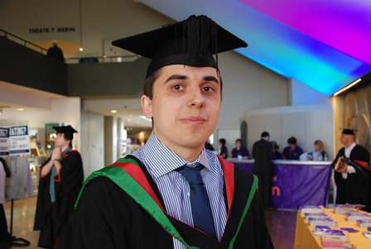
Will Smith
from Bournemouth
AI and Robotics
Presented his work on sailing robots at the
International Robotic Sailing Conference 2012
Final Year project: Losing Beagle B – learning from an autonomous sailing robot
BH-CD Systematic trading, a London hedge
fund company

Slide 29
BSc Computer Graphics, Vision and Games: G450 – 3 years, G451 – 4 years
Specific applications include games development,
(medical) image understanding, movie special effects and
industrial quality control
Covers:
  Core modules plus: appropriate other modules such as: interactive
  computer graphics, image processing, computer vision, C++,
  machine learning
Types of final year project:
  Detecting seed germination from time-lapse,
  3D visualisation of planetary terrain,
  evolutionary art on a mobile device

Slide 30
BSc Computer Science with a foundation year G40F (4 years)
NEW this year!
A gentle introduction to Computing
Can change to any other scheme after successfully passing the foundation year
Ideal for mature students or those who did not do as well on their A-levels as expected
Notes:
30

Slide 31
How to get more information:
Today:
Please ask! cs-admissions@aber.ac.uk
While making your decision about University:
http://courses.aber.ac.uk
http://www.aber.ac.uk/modules
After you apply:
Visit Days
Once you are here:
Lots of support available – if you are worried ask!

Slide 32
Other 2nd year individual games
(from the Interactive web programming module):
Connor
Gideon
Natalia
Notes:
CS252 Interactive web programming: HTML5, JavaScript
32

Slide 33
Un o’r pecynnau gorau o Ysgoloriaethau a Bwrsariaethau yn y DU
One of the best Scholarship and Bursary packages in the UK: http://www.aber.ac.uk/en/scholarships-bursaries/
The above masthead is mandatory on the first slide of every University presentation.
Department Colour.
Ar gyfer POB cwrs
Yn ychwanegol i grantiau / benthyciadau
Gwerth hyd at £15,000
Available for ALL courses
In addition to grants / loans
Receive up to £15,000
Am wybodaeth ar beth allech CHI dderbyn, ewch i’r wefan
For information on what YOU could receive visit our website
Notes:
Title page

Slide 34
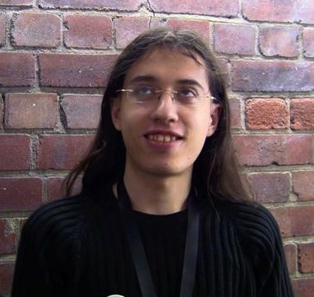
Emanuil Tolev
From Bulgaria
Computer Science – G401
Worked for Information Services
in Industrial Year
Final project: Mapping out scientific
funding opportunities
Won JISC funding of £5000 to
further develop his project in summer
2013 (Student Summer of Innovation)
Went to work for CottageLabs in
Cardiff/Edinburgh as an open
source programmer

Slide 35
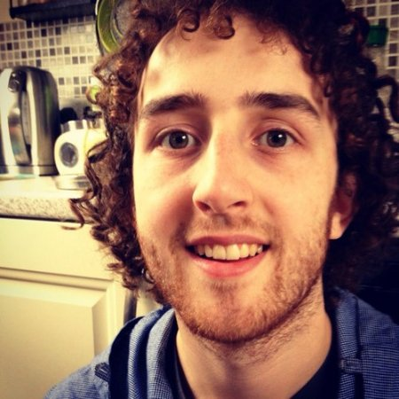
Matthew Harrison-Jones
Internet Computing
Developed an HTML5 application to
model fish population for IBERS staff
as a summer project
Final year project: Kinect controls
for an HTML5 games console
Went to work for a Kickstarter-funded
startup company (Ghost)
Now working for Clock, a digital agency
Notes:
35

Slide 36
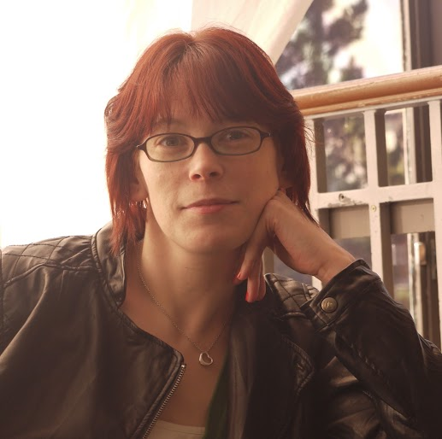
Huldah Knox-Thomas
From Aberystwyth
Internet Computing
Did her degree as a mature student,
and a single mother
Involved in volunteering, RAG,
Mature Students Union,
Union Events and Integration Officer
Final year project:
A one stop site for all information
relating to events, people and places in
Aberystwyth
Still organising events in Aber now.
Notes:
36

Slide 37
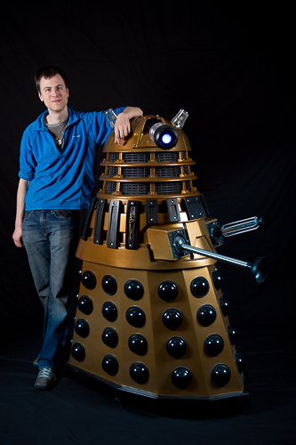
Tom Blanchard
from Brighton
AI and Robotics
Industrial Year working for
Dr. Mark Neal in the department
Final Year project: Development
of an Autonomous Tethered and
Submersible Data Buoy
Now: PhD

Slide 38
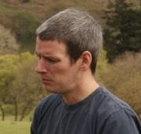
Rob Yeates
From Somerset
Mature student (was a catering manager)
Industrial year at Goldman-Sachs,
Final Project: System using Transport
for London data
Was on MEng but they offered him a job,
so graduated with first class BEng!

Slide 39
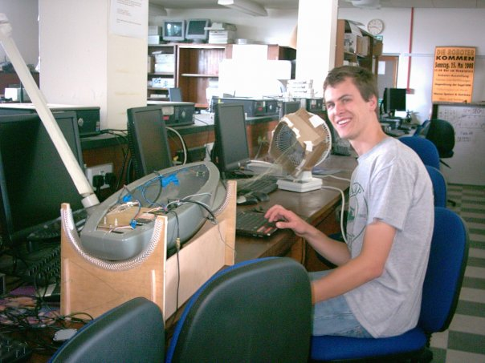
Tom on a project involved with automated 3D
modelling of the calving edge of glaciers

Slide 40
What is computing?
Computing is the study of how computers and computer
systems work, and how they are constructed and
programmed, and the foundations of information and
computation
explores principles and ideas rather than artefacts
creators, not just consumers
[CAS white paper, 2010]
Notes:
Not many places get high marks for both teaching and research
40

